Slide 1
School Bills and End of Year Processes
PDF version of this PowerPoint does not contain all images and features!

Slide 2
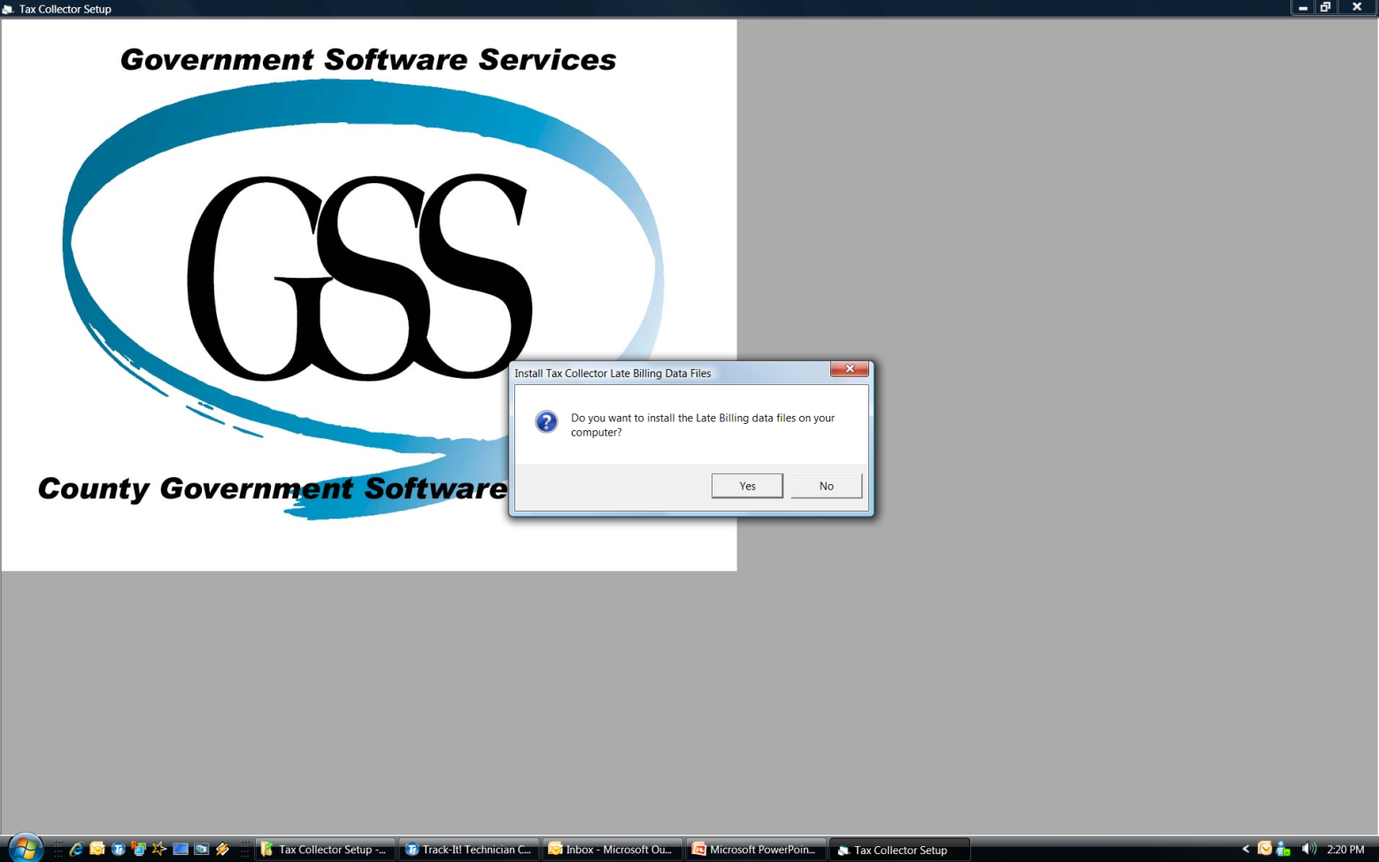
Installing School Data to GSS Software
Install the School Data Disk in the Computer, it is set to run up automatically to the screen below.

Slide 3
Installing School Data
Make sure no other software is open when installing the data.

Slide 4
Installing School Data
Your disk may only have your District # on it, your School District name or it may say County-wide data. This is due to the way we verify the school data, but regardless it will have your data on it. It may take a minute or two before you see it load data as it searches for your particular district. It will load Real Estate first, then Per Capita, and if you have any it will load/update Tax Claim information.

Slide 5
Installing School Data

Slide 6
Install School Data

Slide 7
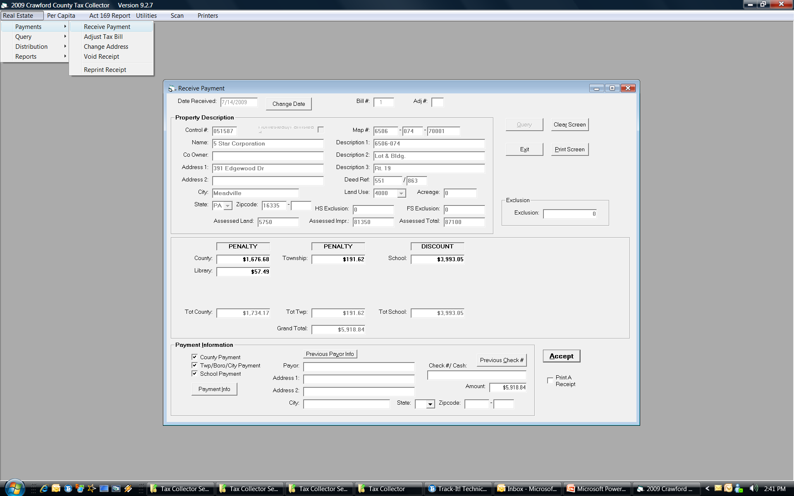
Verify Installation of School Data
Open the Tax Collector Software, then go to Real Estate, Payments, Receive Payment enter a Tax Bill number then tab out. When the page populates with information you should see the School data added. You will know that you now have the school data added to your software! But we still have some work to do!

Slide 8
Tax Certification
New for 2015 this quick process allows a Tax Collector to quickly provide the necessary data needed for most mortgage companies, lawyers, and other requestors wanting payment information for a parcel.

Slide 9
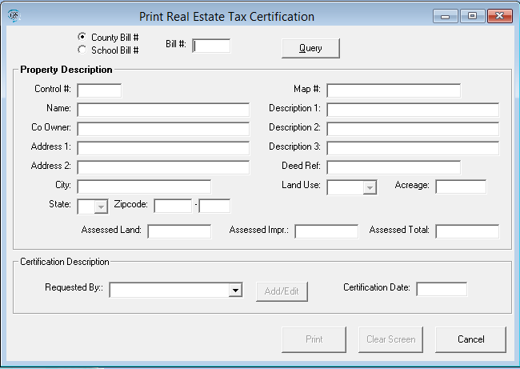
The Tax Certification Process
Here is the screen that populates when you select Tax Certification. Either enter a Bill # and “Tab” out or select “Query” to find the parcel you need the information for.

Slide 10
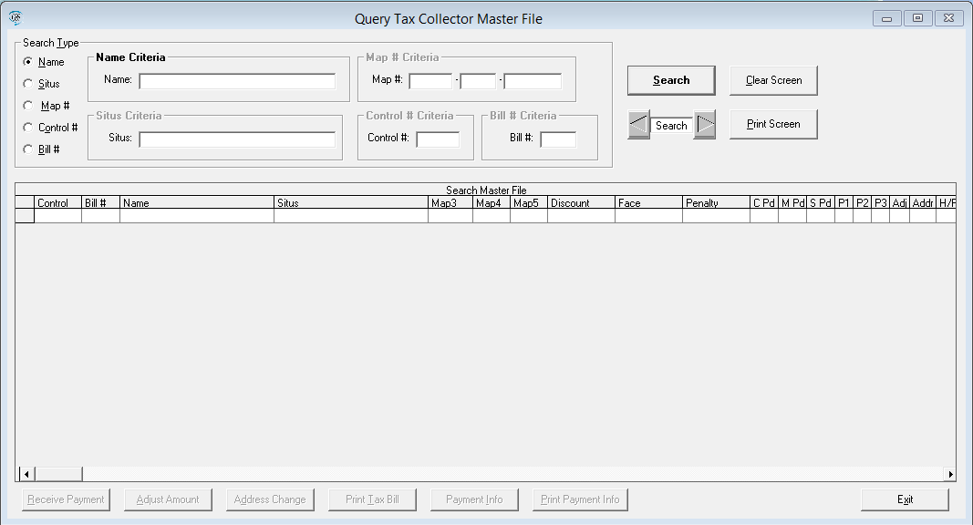
Tax Certifcation - Search for Parcel
This is the query module used for searching the Master file. You can select your search type on the left and then enter the appropriate search terms in the highlighted field. Currently once you find the bill # of the parcel you need to certify you will need to type it into the Tax Certification module.

Slide 11
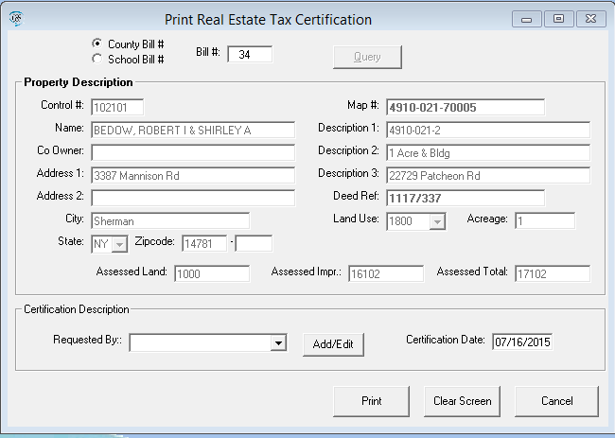
Tax Certification Entry
After entering a Bill # and hitting “Tab” key it should load the screen as in the example below.

Slide 12
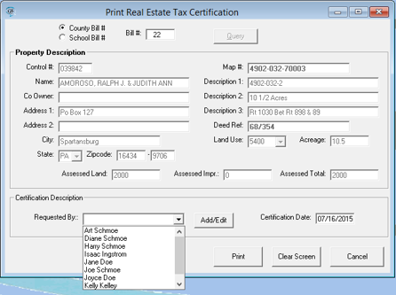
Adding a Requestor
You may type in a new name or click on the same arrow shown where the red arrow is pointing to select from previously entered requestors.

Slide 13
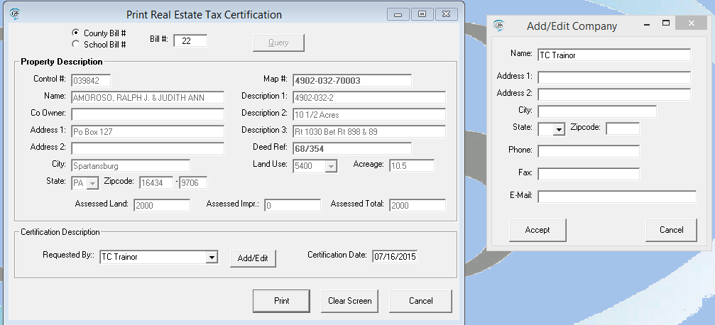
Adding a Requestor
When you enter your requestor and hit “Print” the small window on the right comes up for you to enter additional details. Note: Only the name will print on the Certificate no matter how much information you enter.

Slide 14
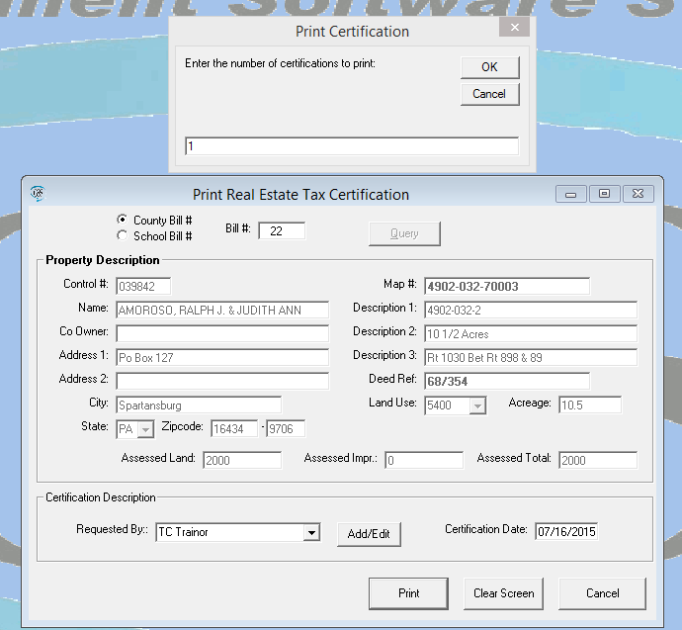
Printing the Certification
The print module will come up with the default print of a single copy. Change the number should you need more.

Slide 15
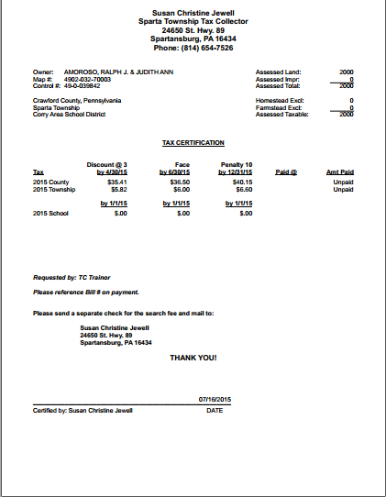

Slide 16
What do I do now?
You have your school data in the system and you are about to receive the Books and Duplicates. What actions do you take to ensure the School bills are correct before sending them out to the public?
Did you add bills to either your RE or PC tax duplicate for County or Township? If yes, then you need the school portion of those bills since the County does not have the information.
Did you exonerate any County or Township RE or PC bills? If yes, do those exonerations need to carry over to school bills?
Did you change any Address information for RE or PC bills? If yes, then the addresses from the printer may need updated (see note in next section on this)
Would you like the school portion of the added bills printed?
How would you like your computer to do most of/or all this work for you? If yes, then you will want to use the Late Billing Routine!

Slide 17
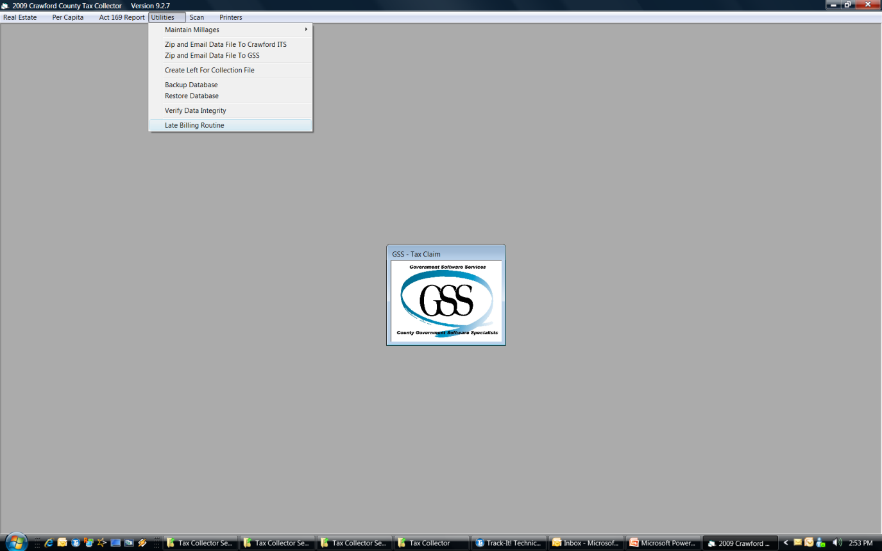
The Late Billing Routine
The path to the Late Billing Routine is found under the Utilities menu.

Slide 18
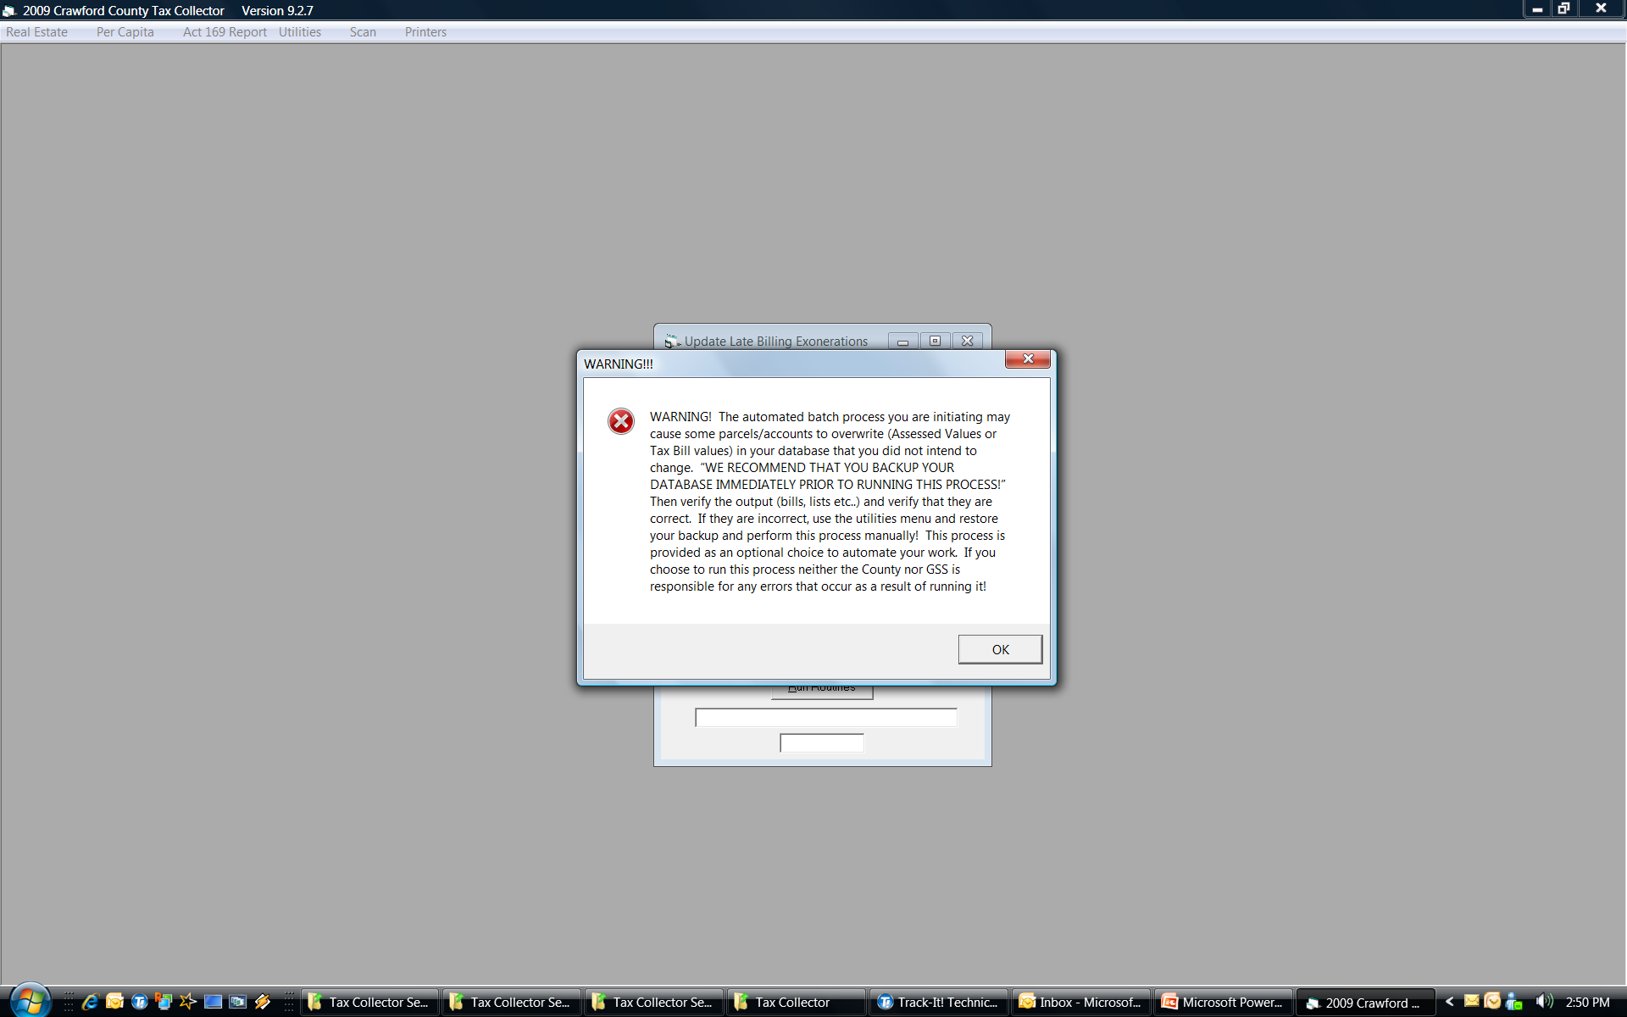
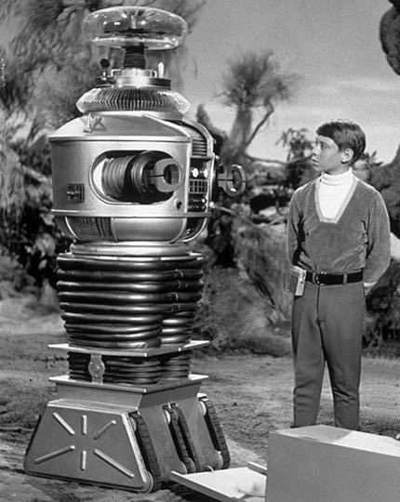
The Late Billing Routine
WARNING WILL ROBINSON!! No you won’t have enemy robots attack you if you use this feature! But you will be causing calculations to occur when you run it. I recommend that you backup your data before proceeding!

Slide 19
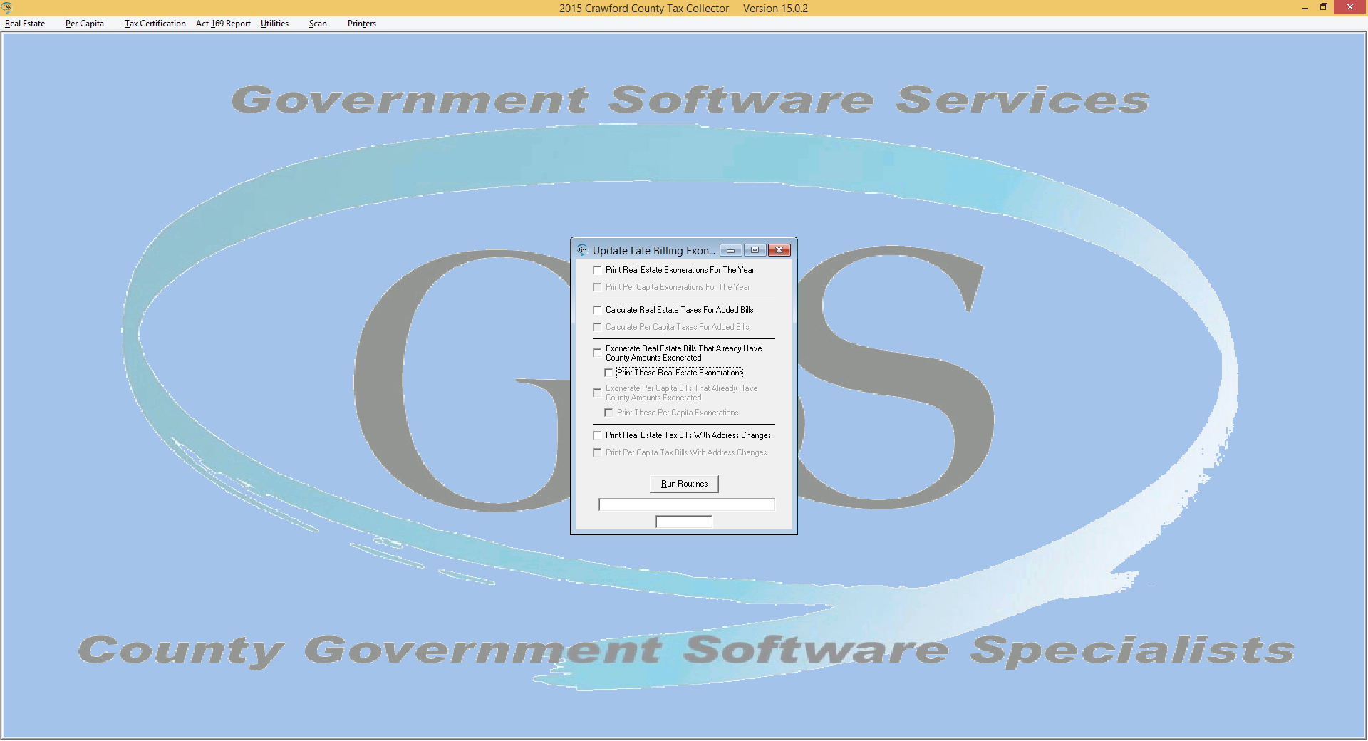
The Late Billing Routine
This process brings the school bills up to date with the data in your local machine. A confusing statement, but the county does not have all the information that you put in the software since the beginning of the year. Therefore to get the RE and PC duplicates and bills correct for the school we need to match them against the data you’ve collected.

Slide 20
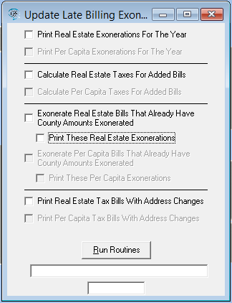
Late Billing Routine
You have several choices to make here. Your first choice is do you want to use the late billing routine? Remember if you don’t use it you will have to do all these processes manually!
Processes and why they are run:
Print RE exonerations – this is done first to show what exonerations you already have in your software. We call this a baseline report.
Calculate RE Taxes for Added Bills – The county has no way of knowing who you’ve added to the duplicate, this makes sure a school bill is put in place for them.

Slide 21
Late Billing Routine
Exonerate RE Bills that Already Have County Amounts Exonerated – This carries over to the School the exoneration. The school portion of the bill will be set to zero for each bill that has a county amount set to zero!
Print RE Exonerations – Since these are adjustments to the School duplicate you will need to see the adjustments. This prints them out so you can view them.
Print RE Tax Bills with Address Changes – Although we update RE addresses from your input we only do it for same owner situations. This will update data to what you have in your data. Since we don’t update Per Capita during the year this will change it considerably.

Slide 22
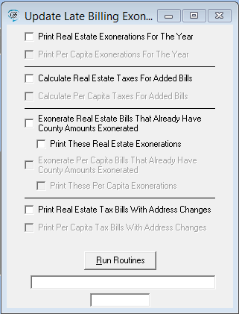
Late Billing Routine
6. Print RE Tax Bills with Address Changes – Although we update RE addresses from your input during the year we only do it for same owner situations. This will update data to what you have in your data. Since we don’t update Per Capita during the year this will change it considerably.
Warning – If you selected all the printing selections you have 3 print jobs about to start. Make sure you have paper in your printer and a good ink cartridge before hitting the “Run Routines” button

Slide 23
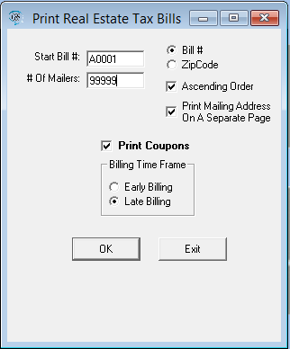
Late Billing Routine
Although this step is not included in the Late Billing Routine it is the final step to finish bringing your school bills up to date. You will need to print your school portion of the added bills. Go to Reports print Tax Bills for RE (if you have any added for RE). Where the “Start Bill #” is at enter A0001 and then in “# of Mailers” enter a number higher than the number of added bills. When done you will need to add these bills to your mailing!

Slide 24
Late Billing Routine
Do I have to eat the whole enchilada?
NO!
Choose the things that you want the system to do for you!
This process is designed to save you time!
You can also run a few processes one day and save others for later, but all processes must be complete either by the system or manually before the school bills go out!
NOTE: There are times when you might not want the system to perform exonerations. A hypothetical example would be LERTA’s that are for County and Township but not school. In that case you would not want the exoneration to carry over so you would not select the options to exonerate school bills.

Slide 25
Receiving Books and Bills
No matter where you receive your books and bills from (County or School) you should do the following:
Inventory – When I inventory a shipment from the printer I’m only verifying that I received the correct number of boxes and that all the duplicates are present. We do not inventory the RE and PC bills to ensure they were all printed! So you should check your duplicate and verify that you received all your RE and PC bills!
Missing bills – our vendor uses high speed printing systems. As good as they are there is the possibility that some bills may be missing. If you find any missing please contact me for County/Township and this year School. I will get them printed and drop shipped to your home. If time is too short for a 3 to 4 day turn around come to the Courthouse and I will print them on plain white paper for you.
Check duplicate totals – Verify against the Summary Report in the software to ensure the figures are the same. If not call me as soon as possible!

Slide 26
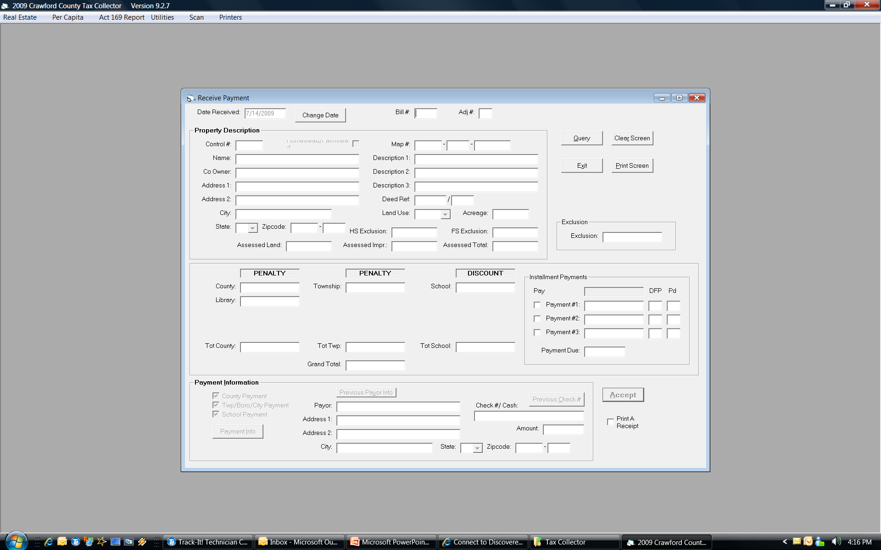
Receiving School Payments
OK, where do I take in School Dollars?
The highlighted area shows fields added when school data is loaded.

Slide 27
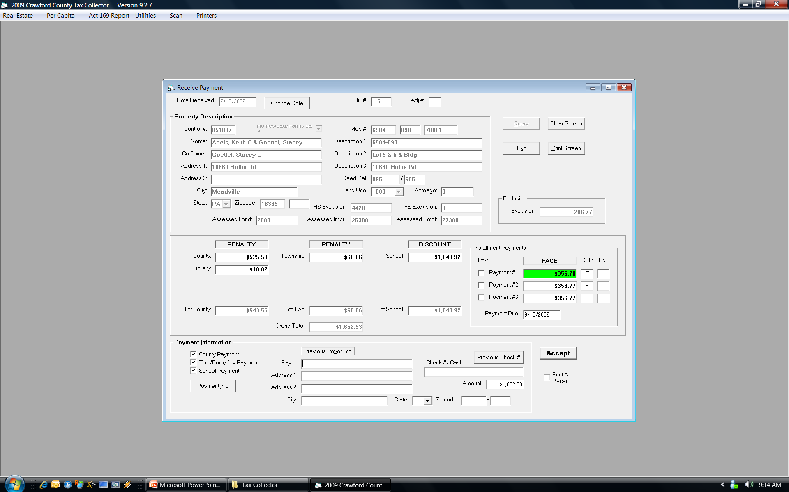
Receiving School Payments
Below is an example of a Homestead/Farmstead (H/F) bill loaded to the system. You may take the full payment (Highlighted in Yellow) or you may take installment payments (Highlighted in Red)

Slide 28
Receiving School Payments
Just a reminder! Act 1 (commonly referred to as the H/F Act) makes a property eligible for both: allowing installment payments and receiving an exclusion. Non-H/F properties must use the normal Discount, Face, and Penalty method of payment and they do not receive an exclusion or tax reduction!
The County School Districts limited installments to just 3 payments! The advantage to this for the Tax Collector is that you don’t have to track late installment payments! Had they allowed for four payments then the law required tracking of late installment payments and revocation of installment payment privileges under certain criteria!
The first installment must be paid during the discount period specified for them! If not the taxpayer is not eligible to use the installment payment process!

Slide 29
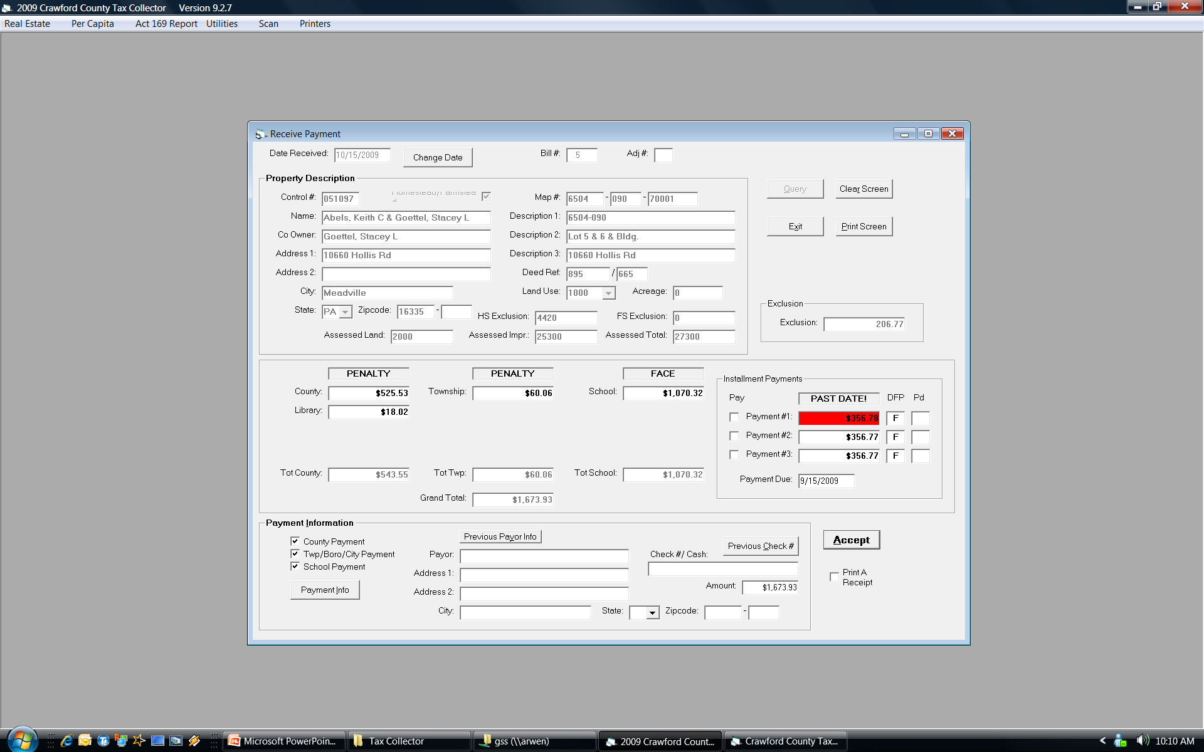
Receiving School Payments
Accepting full payments is done exactly the same as for County and Township; so let’s focus on installments. You can see in this screen that the first payment is highlighted green. That indicates the payment is in the discount period for the installment and can be taken! If the date is after the discount period for the 1st payment the box turns red and no installment payments can be taken. The taxpayer by failing to meet the deadline has indicated they are not doing installments!

Slide 30
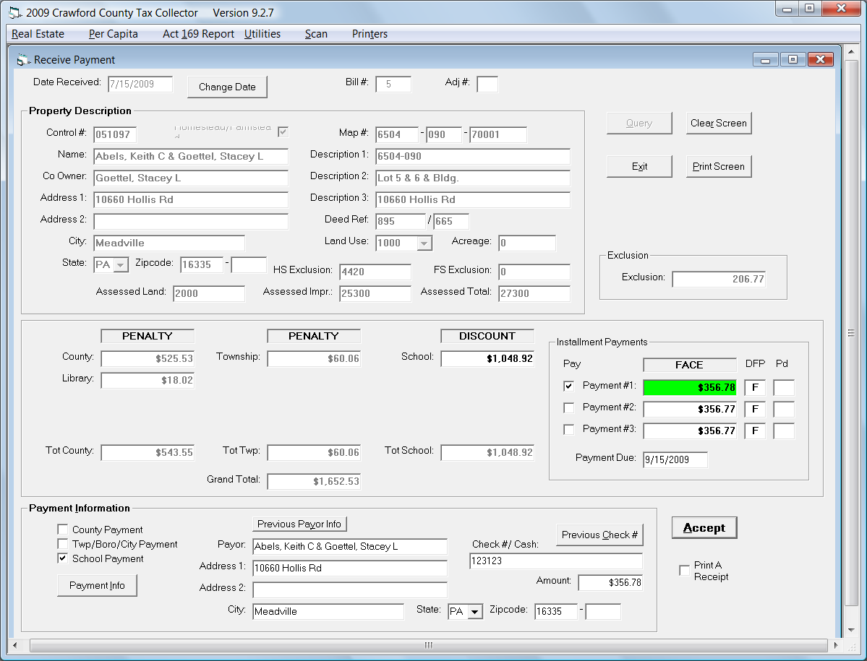
Receiving School Payments
Lets take this payment!
Click the box next to Payment #1
Note: the amount in the Payment Information Area now reflects the installment payment if just a School Payment is being received. You now just need to enter Payor and Check/# Cash and accept the payment.
Notes:
By taking an installment payment the system now will not let you take a regulare Discount, Face, or Penalty Payment!

Slide 31
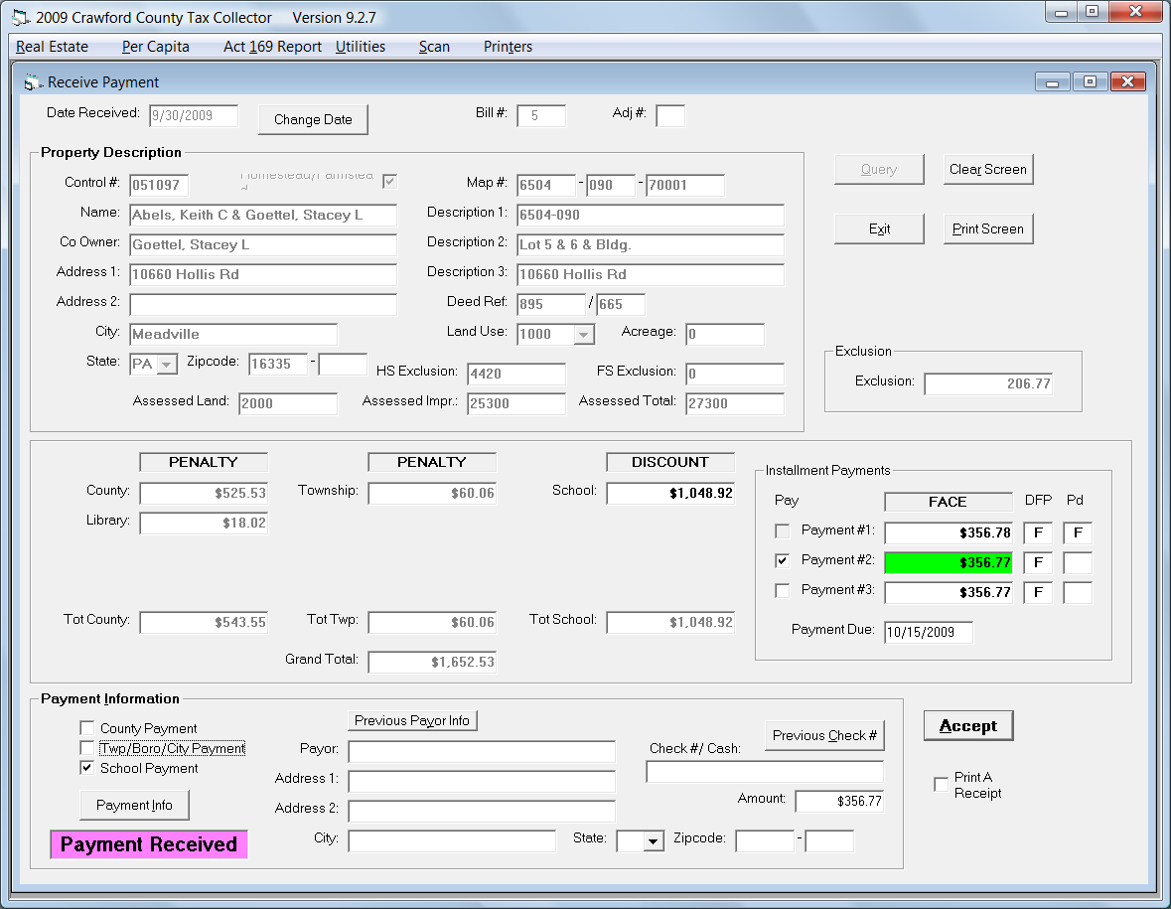
Receiving School Payments
Once the first installment is received the system automatically sets you up to take the 2nd installment. It also records the period in which each installment is paid. The first column indicates the current period based on data. The second indicates the period the payment was entered. Remember, installments don’t have a discount period!

Slide 32
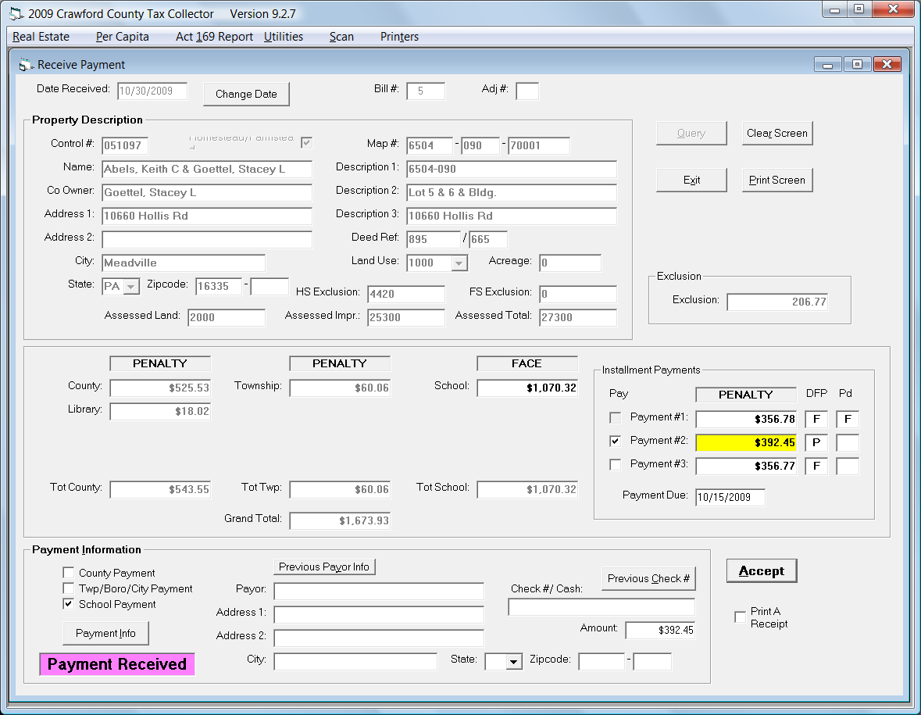
Receiving School Payments
As shown earlier if Payment #1 goes past the Face period you cannot accept installment payments. However payments #2 and #3 can be taken at penalty. Below is an example of a payment in the penalty period. The amount color changes from green to yellow the status changes to PENALTY and status the DFP shows.

Slide 33
End of Year Processes
Several thing hit quickly at the end of year:
- In December you have to get out 2nd Notices for School Real Estate Bills.
- You have to prepare to turn in to the Taxing Authorities and all this during a busy Holiday time!
- You have to do reports and submit them to Tax Claim. Which may be the first business day of the new year!
The Software should help you with all three of these processes! So lets go through it!

Slide 34
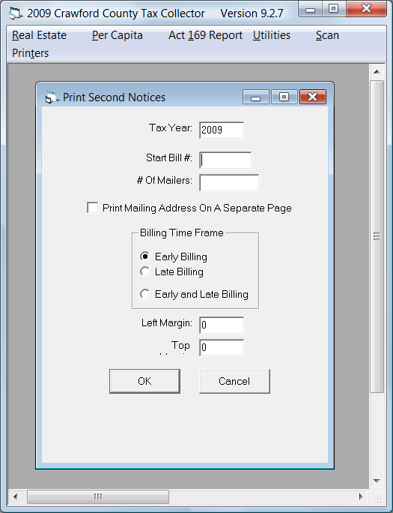
2nd Notices
Printing second notices changed in 2008, the software now allows you to choose three options for printing 2nd notices. With the addition of doing Early and Late together at the end of the year you can see significant savings on ink/toner and paper! This places any outstanding Tax Due on the notice and totals them at the penalty amount to render a Total Amount Due at Penalty!

Slide 35
2nd Notices
To print 2nd notices for your entire district enter a Start Bill # then enter a # of Mailers that exceeds your total duplicate count. Just to be safe you can enter 9999 and that will do any district in the county.
Some tax collectors have opted to bring in their backup and have us print these at the courthouse so we can duplex print these (to get the mailing address on the same piece of paper). If you decide to do this please call ahead to schedule and we will try to have them done the same day! (no promises though)
1
9999

Slide 36
Sample 2nd Notice

Slide 37
Returns and Left for Collection
Tax Collector software allows for efficient recall of data for reports
Two reports are provided:
Returns Proof, which is built just for Tax Collector use.
Left for Collection report which is used to turn in unpaid or partially unpaid (installments) parcels for Delinquent Tax Collection!
The Left for collection has two sections and a summary
Both reports are pretty self-explanatory the following are samples

Slide 38
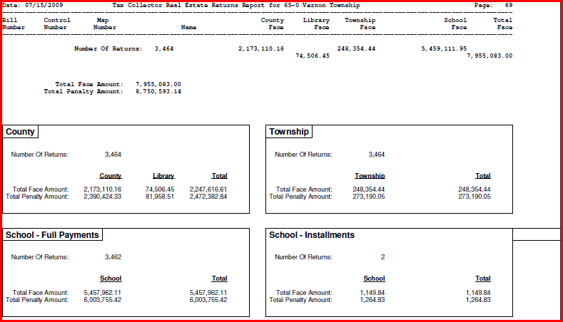
Sample Returns Proof

Slide 39
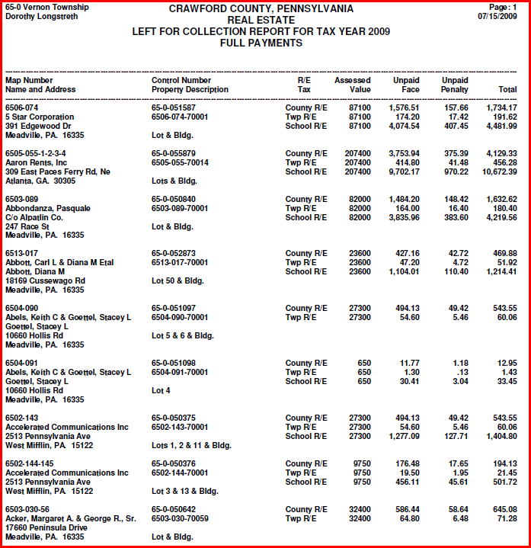
Sample Left for Collection

Slide 40
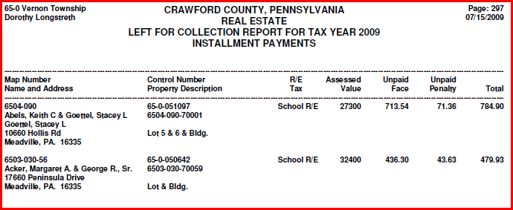
Sample Left for Collection
On the prior page the list shows full payments, did you notice that the highlighted entries did not have School listed. That is because installments were taken.
Below you can see the result of incomplete payment of School installments. We did a separate section for these since the amount is only a partial of the full amount due. Installment payers never pay the full penalty! That is because the first payment has to be made at Face and the law relegates collecting penalty only on the Face amount of each coupon so only 2 payments can have penalty applied!

Slide 41
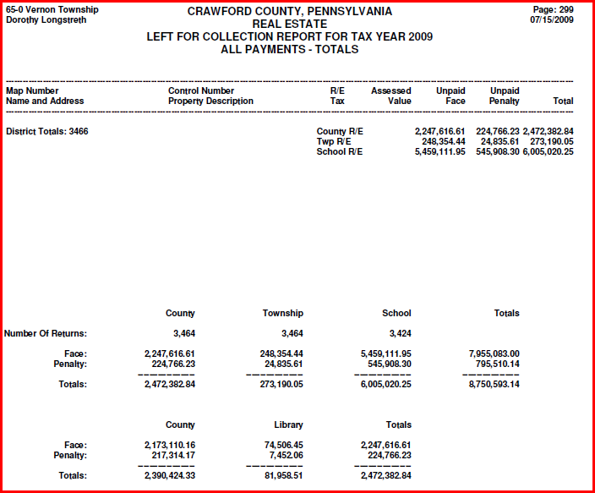
Sample Left for Collection
This is the ALL PAYMENTS summary! This totals both full and installment payments and shows the amount remaining to be collected.

Slide 42
Closing Data Entry!
OK, when do you stop doing data entry?
When you turn in your Left for Collection report to the Tax Claim Bureau for Real Estate and when you report your unpaid Per Capita to the Collection Agency.
You should not receive Real Estate Taxes after you have turned in to the Treasurers Office, and you should bring ITS a backup of your database at the same time!
Also do not enter Per Capita payments to the computer after you report to the Collection Agency. There is a form for you to record Per Capita payments taken between the date you send the Collection Agency and the physical end of the year. That form should stay in your records for audit purposes!
NOTE: Per the law you may not receive current year payments after the Tax Delinquent date!

Slide 43
Turning in Your Data
Make a backup of you database and bring it to the ITS Office when you do your turn-in to the Treasurers Office. We will do the following for you:
Extract your returns information and load it to the Tax Claim system (this is where the county receives payback for providing you with free software!)
Store your end of year data on the county servers and keep an off-site copy of your data. This has proved useful over the last few years in helping Tax Collectors recover from system crashes or loss of data.
Remember the file name for your backup is: Dist##Taxcollyyyy-mmddyyyy.bkp the .bkp stands for backup! No other file can be accepted!

