Slide 1
Leveraging ArcGIS API for Python:
Uncovering GIS Interactions
Crawford County
GIS Manager: Andrew Parkin
Notes:
Greet everyone a good afternoon.
Thanks for joining me on my talk about leveraging ArcGIS API for python
Skill level
By a show of hands who he has use python before?
How many of you have used the API before?

Slide 2
Objectives
Quick introduction of ESRI’s two python Libraries
Examples of how to leverage API for Python
Deep Dive a API for Python use case.
Questions

Slide 3
Notes:
3.5 Years of programming experience.
Began coding during the initial world shutdown.
Looking back on that time I only really recall doing two things. Learn Python and playing Animal Crossing lol.
Within a month I was able to learn enough python to automate boring data entry so I didn’t have to. I’ve been hooked and haven’t looked back.
So while I haven’t been programming for long I try my best to inspire others to automate the boring stuff!
Or at the very least steal my code… I’m serious go to my GitHub and use it!
Ok that’s enough about me on to the fun stuff.

Slide 4
ArcPy… API…
ArcPy and ArcGIS API for Python are complementary libraries; ArcPy allows you to use, automate, and extend desktop GIS, and ArcGIS API for Python supports the same for Web GIS.

Slide 5
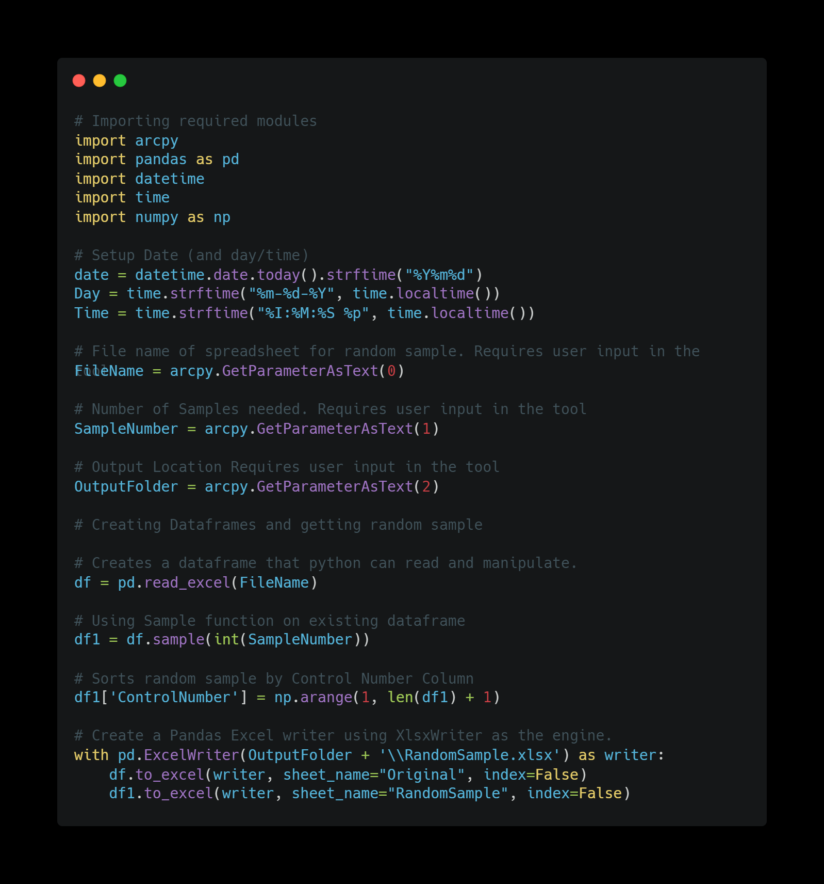
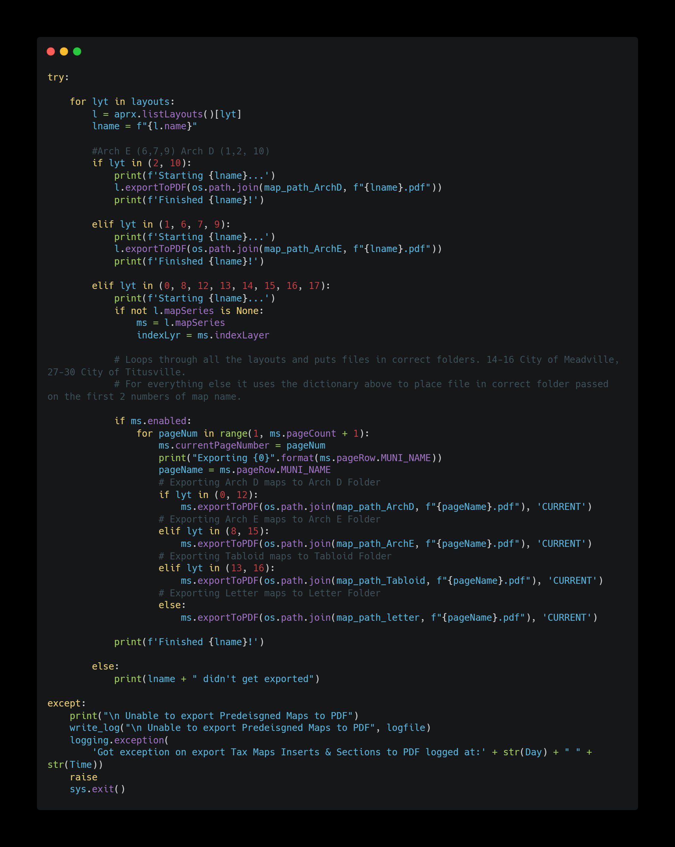
Arcpy Examples
Notes:
Wont spend too much time as this isn’t an ArcPy talk but want to show you a couple of examples to see the difference.
Going to show a custom Geoprocessing tool I created using ArcPy.
FIRST EXAMPLE
Had a department I work with constantly trying to manually pick random samples and in less time (5 minutes) then it took them to explain them to explain the number of samples they needed I had a working random sampler script.
Now they know zero about code but know how to use Geoprocessing tools so I turn my simple script in a simple geoprocessing tool that creates random samples to their heart’s content.
SECOND EXAMPLE
Ok, ok I know this example isn’t lighting the world on fire… Doesn’t necessarily use ArcPy.
So what about automating a monthly export of all your prebuilt maps. For example County, municipal maps. All sorted by size.
Here’s a small chunk of that logic.
Try/Except
Basically telling it to try something if it fails do this instead
For loop through a list of layouts
If a certain layout export it into the correct folder by size.

Slide 6
ArcGIS API for Python
The ArcGIS API for Python is a powerful, modern Pythonic library that supports the latest releases of ArcGIS Enterprise and ArcGIS Online and provides a consistent programmatic experience for scripting and automating across the ArcGIS product suite.

Slide 7
API Uses
GIS Organization Administration
Content Management
Spatial Analysis and Data Science
Notes:
3 Key workflows
GIS Organization Administration
management of users, groups, items, and servers, customizing the look and feel of your ArcGIS Enterprise or ArcGIS Online organization
Content Management
authoring and publishing content (layers, web maps, services), cloning and moving content within and between organizations, editing and updating layers and services
Spatial Analysis and Data Science
data wrangling and engineering, working with spatial data as pandas dataframes, spatial analysis, mapping and visualization, machine learning and deep learning

Slide 8
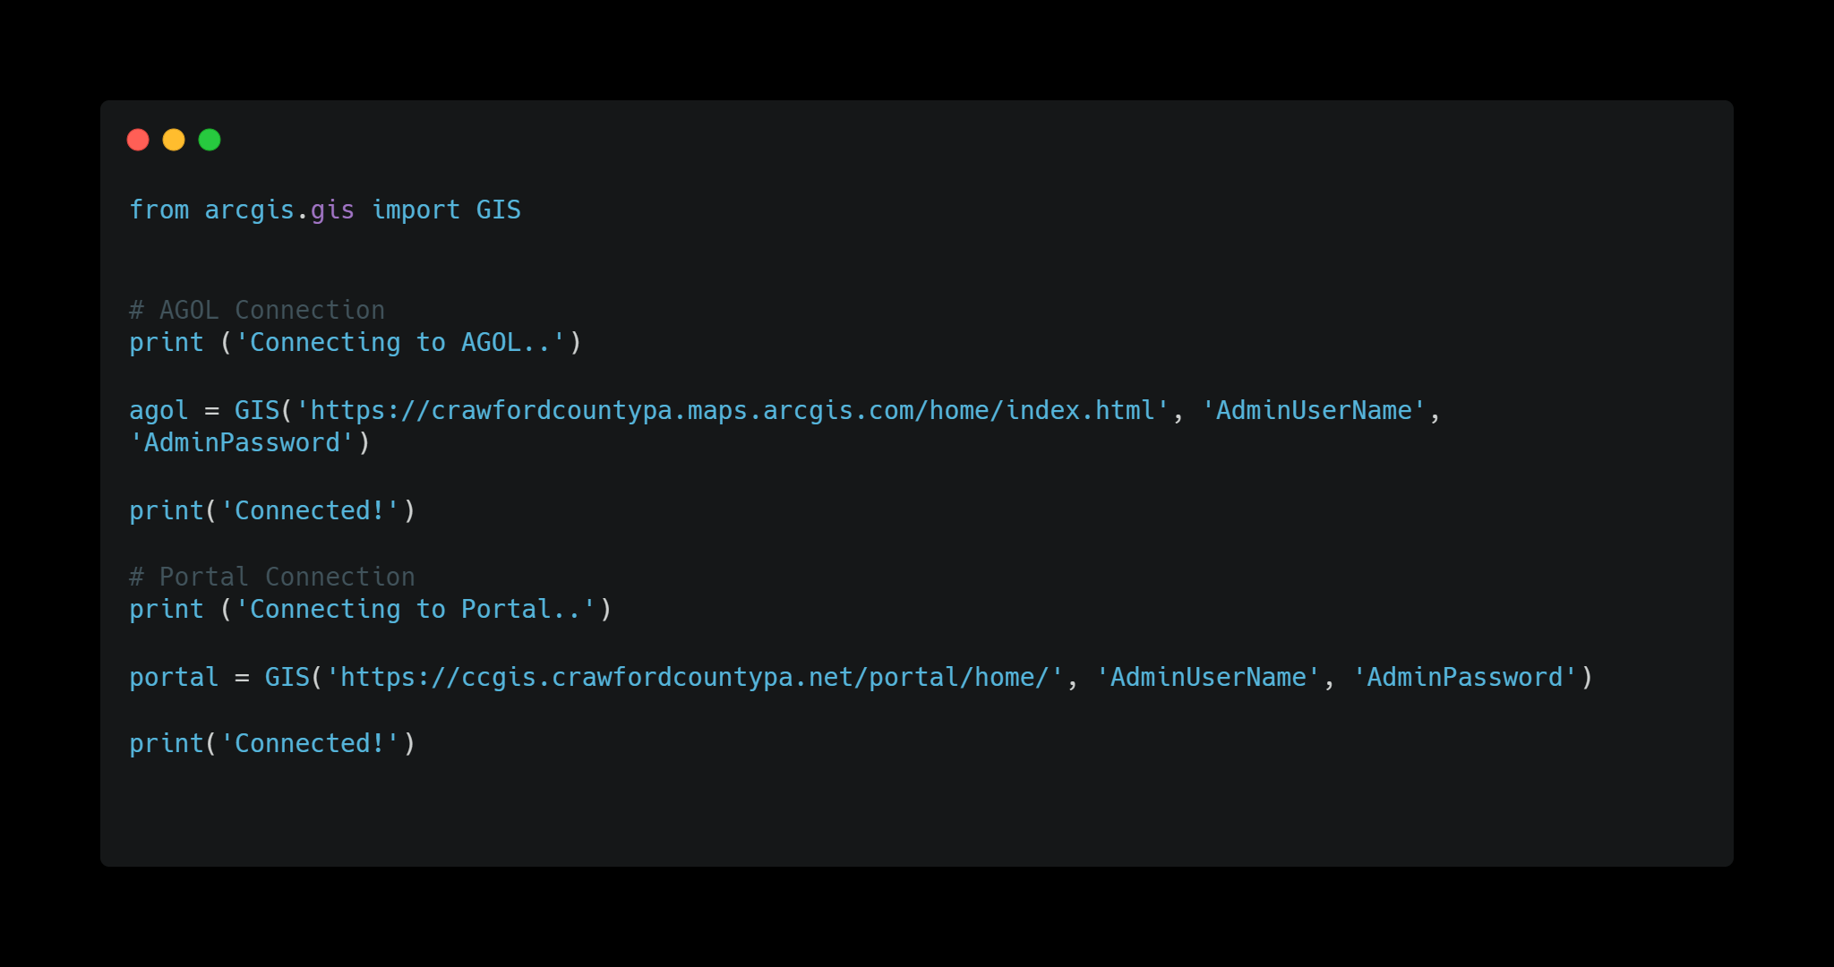
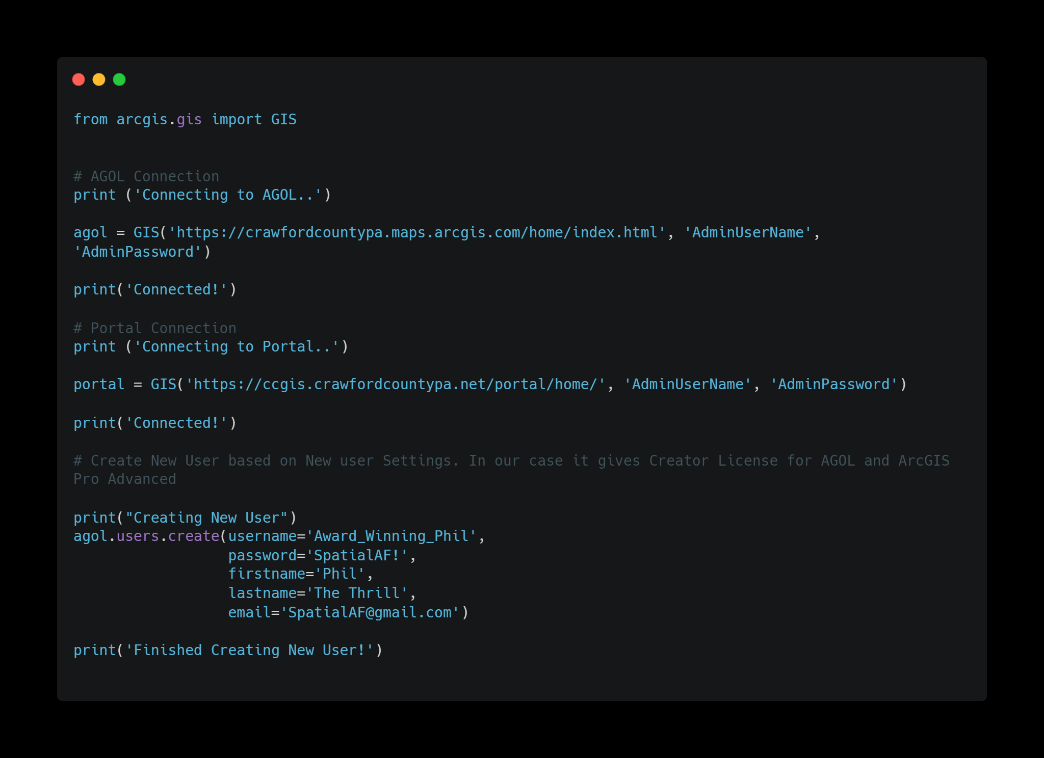
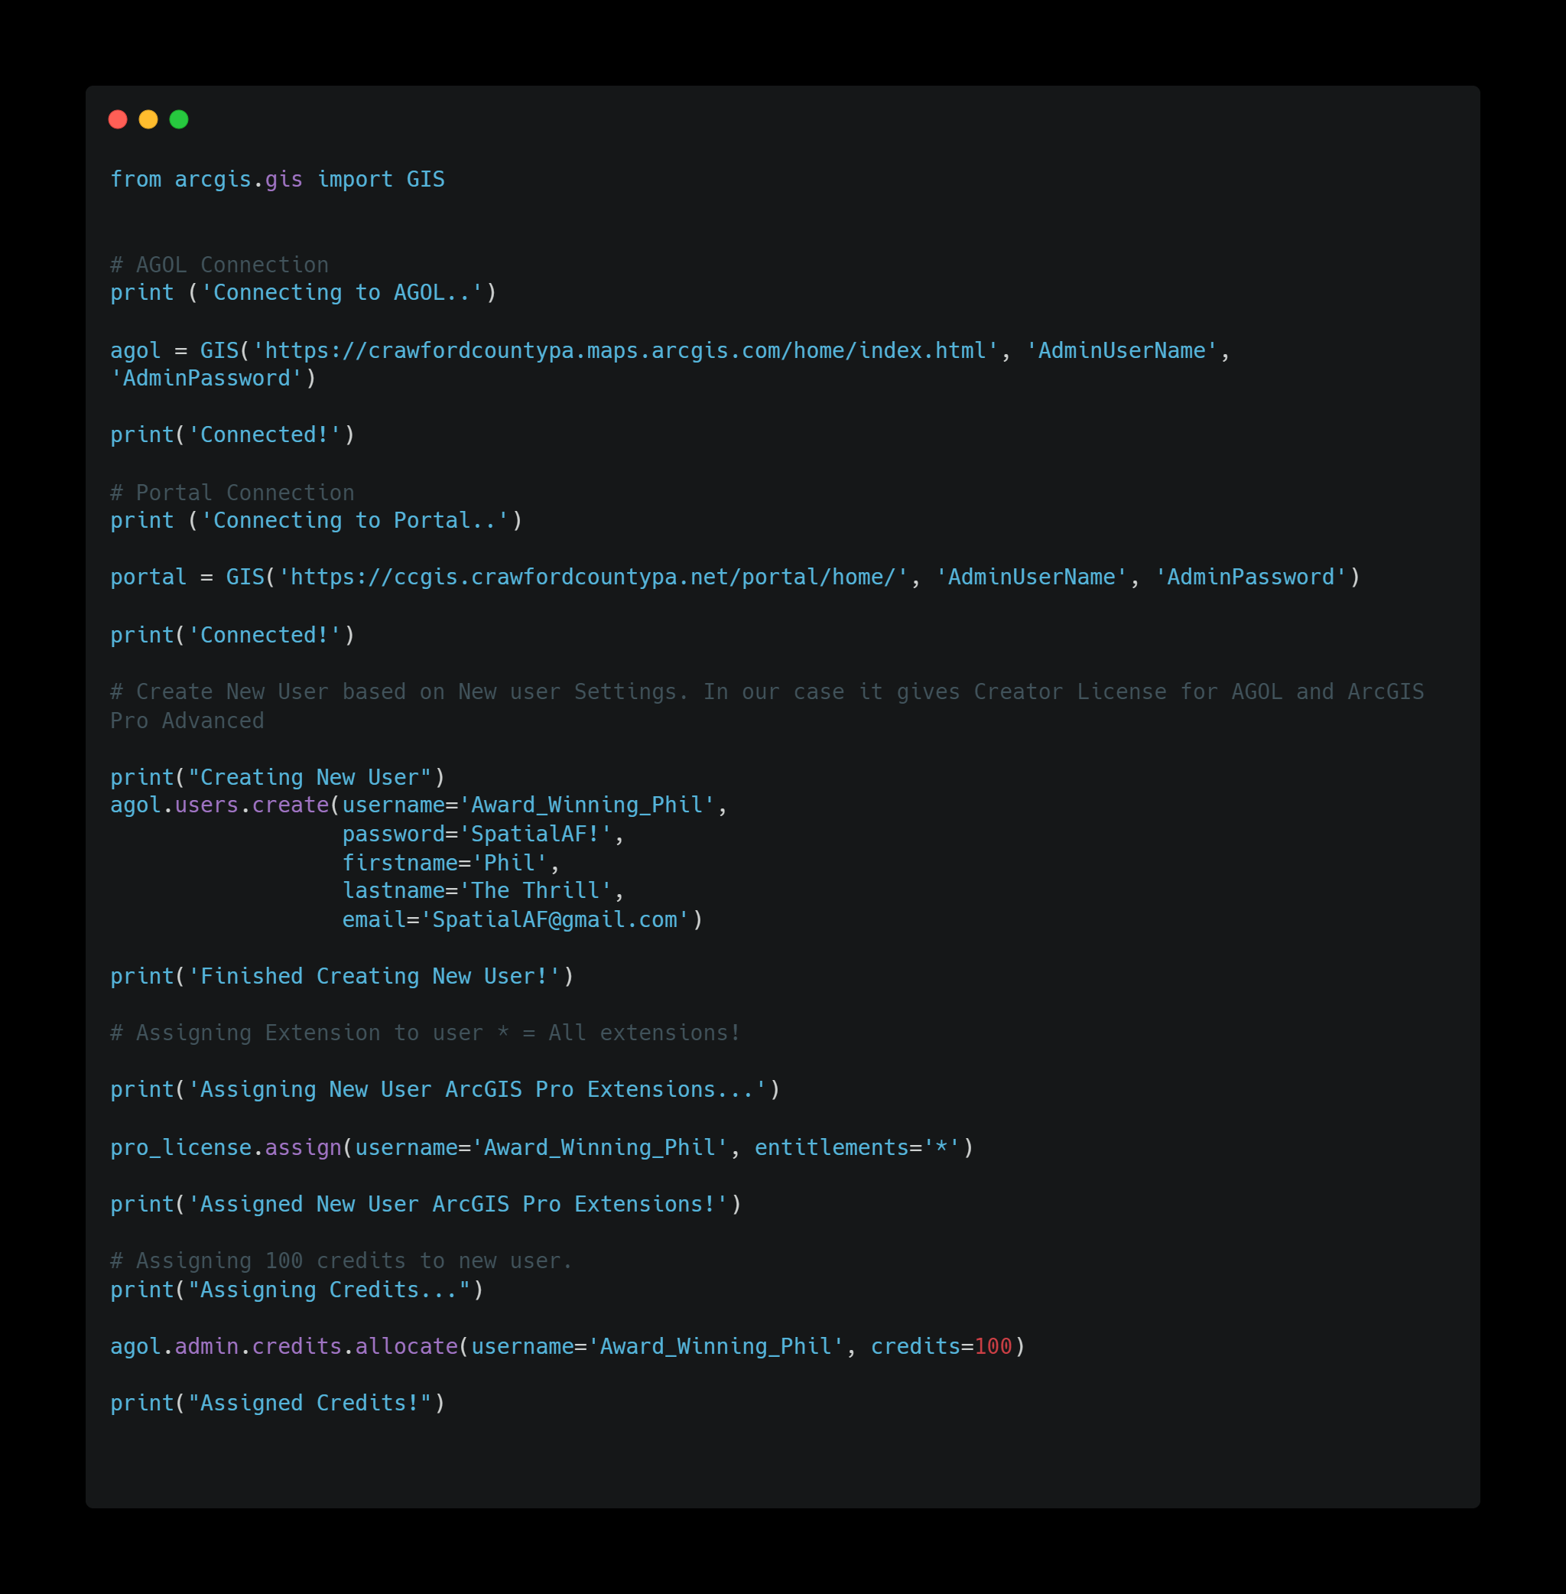
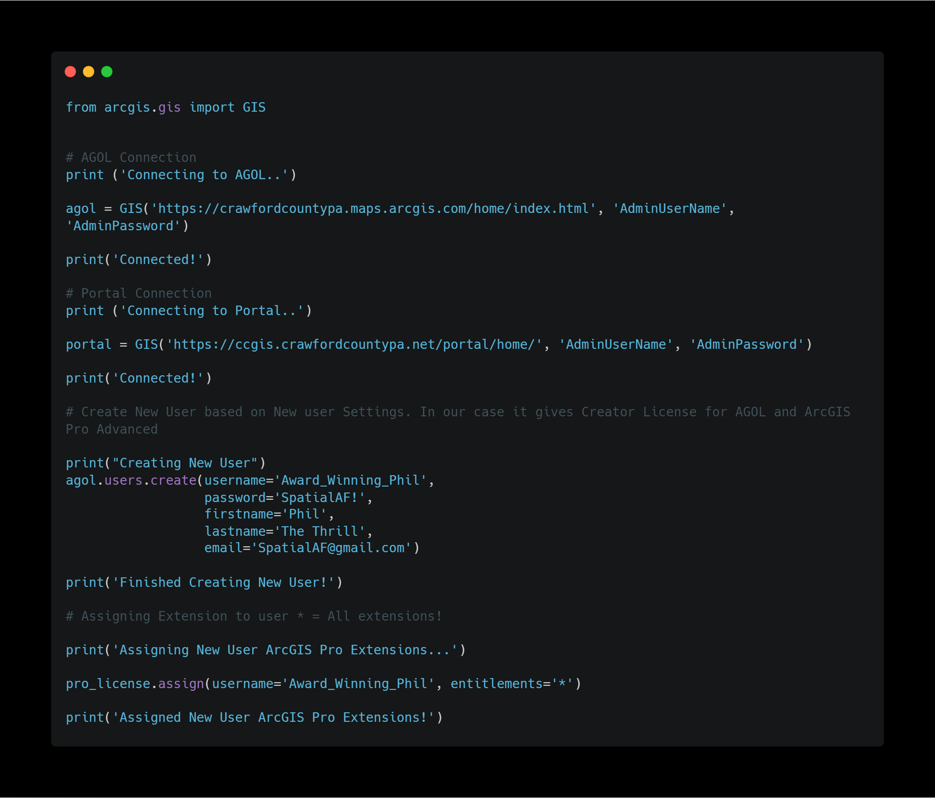
GIS Organization Administration
Notes:
GIS Organization Administration Examples
Connecting to AGOL or Portal
Adding Users using Default new user settings
Assign
Removing Users
Managing Credits
Other Examples include
Removing Users
Adding removing Groups
Adding and removing Servers
etc

Slide 9
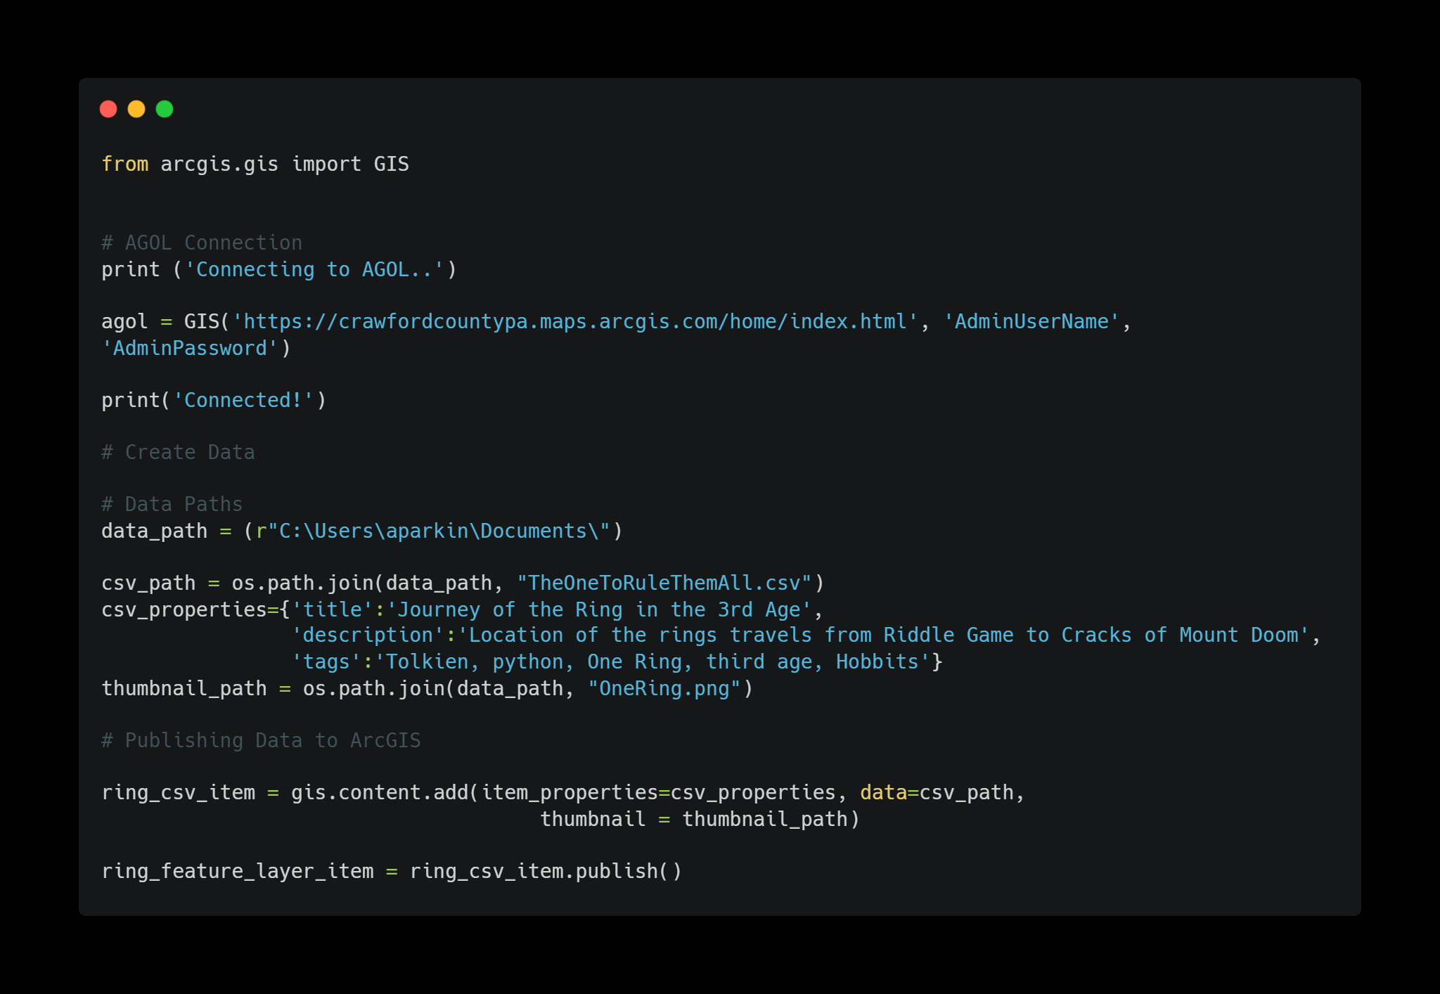
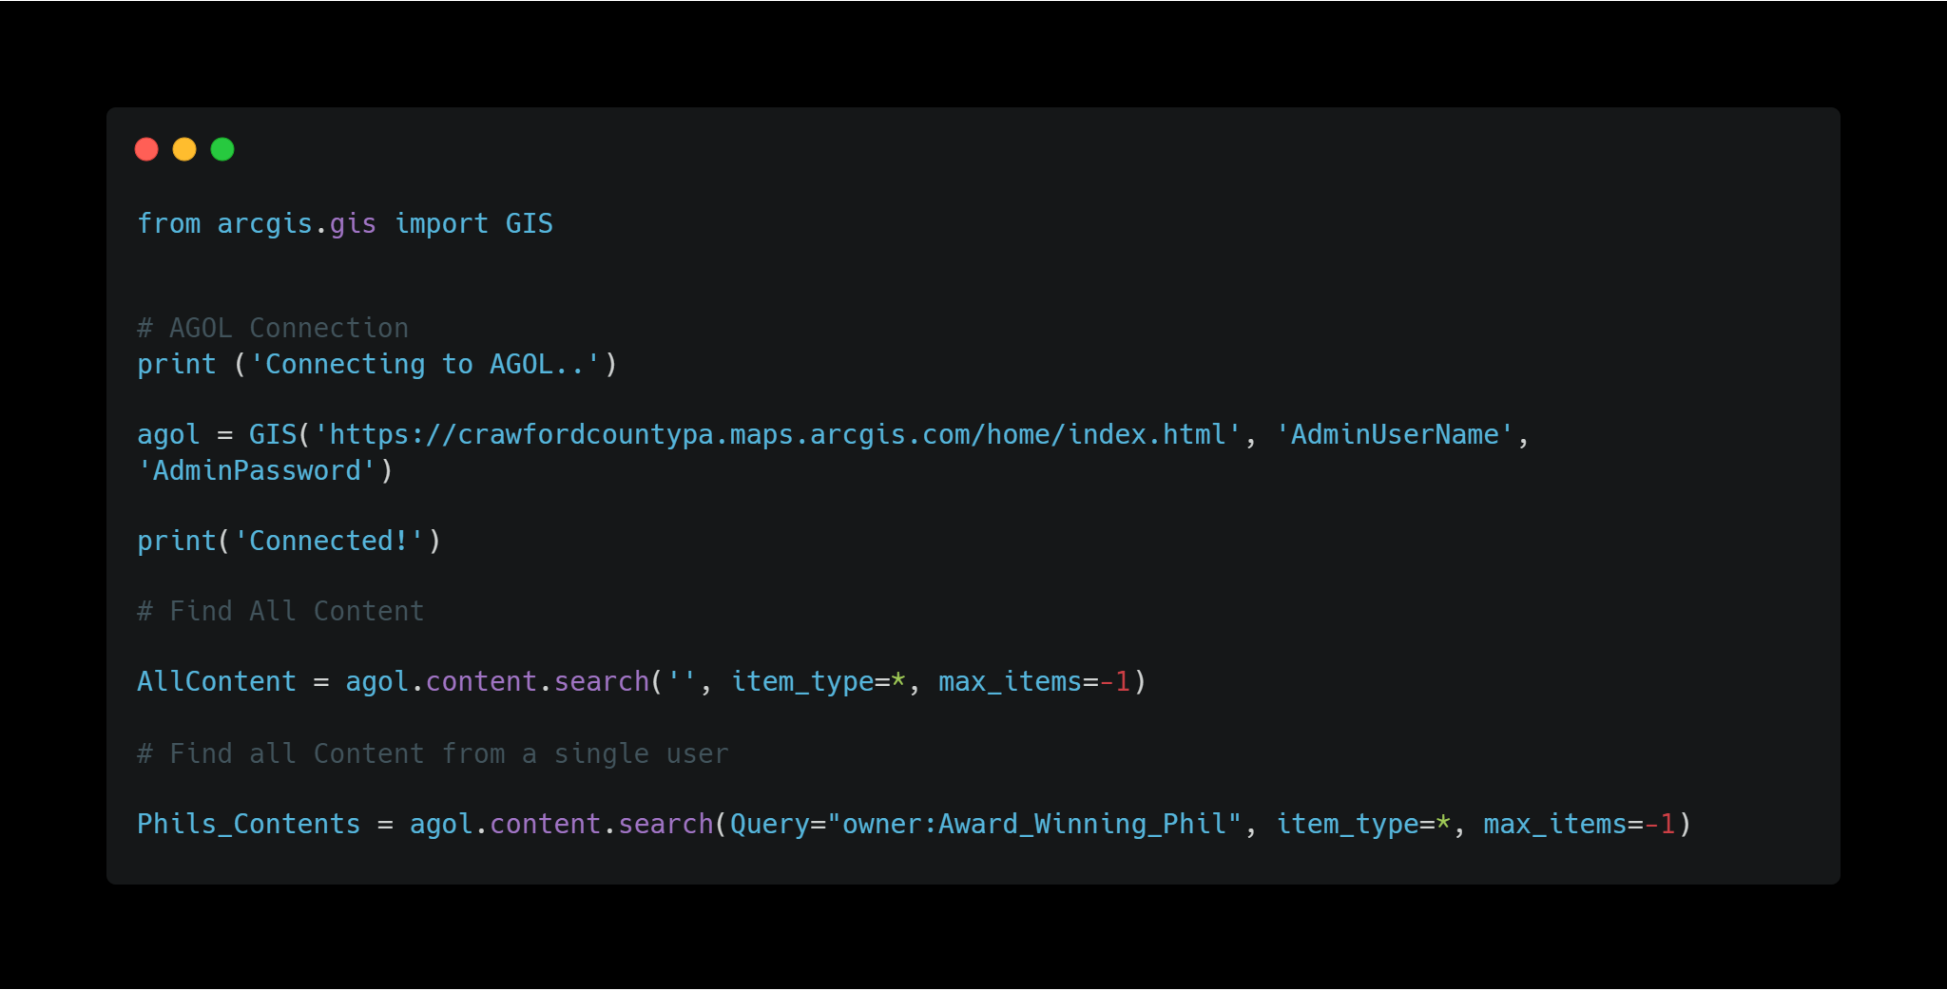
Content Management
Notes:
Find content through Searches
Publishing Features
Other features include
Changing Ownership
Removing Features
Organizing Content

Slide 10
Spatial Analysis and Data Science
Analyzing patterns
Trace downstream
Proximity analysis
Machine Learning
Geoprocessing Tools
Etc.
Notes:
Not something I’ve tried doing with the API so don’t have any good example code wise.

Slide 11
Case Study
This adventure started with a simple question to my good friend and Colleague Phil. Is there was a way to see how everything in my Web GIS relates to each other…?
I don't think there's any prebuilt tool for that but there's always python.
Challenge Accepted!
Notes:
ASK THIS BEFORE CLICKING!!
By a show of hands how many of you utilize Web GIS?
How many of you inherited your Web GIS infrastructure?
How many of you can tell me how any single item is being used in your Web GIS system?
What if I told you after today with 3 simple user input you could see how your entire system interacts with one another?
NOW CLICK
Sounds almost like a QVC commercial right! But Bear with me and you’ll see it’s just that easy!
Thanks Phil.
This Challenge took me head first in the ArcGIS API for Python.
I started small and worked my way up. All in all took me the better part of two work weeks to get a fully functioning script in its current form.

Slide 12
Creation Process
Dual
Environment
Dependency
Single Item
Dependency
Single
Environment
Dependency
Notes:
First Step was to figure out how to find the dependency of a single item via code.
My go to way to search for how to solve new problems is Google.
There will rarely ever be a time where you doing something so cutting edge no one else has come up with a solution
My go to links consist of:
ESRI Documentation
ESRI Community forums
Stack Overflow
Second Step was to figure out how to loop through an entire environment to find all dependencies in environment
Just loop through the 1 item code for each item. Sounds so easy right….
This part of the code took the longest to crack. Going through at least a dozen iterations before finding something that worked.
The key for me was each time it failed I moved another inch closer.
I wish I had all those old work throughs but alas didn’t bother to save them on Github till I was finished.
Third Step link the connection between multiple environments and do a custom sort for the final export. Ex: Find how portal reacts with AGOL
Thankfully this step was rather painless as I could just match up by URL as all our portal hosted items get used in AGOL via rest service url so they matched in both places.
https://community.esri.com/t5/arcgis-online-questions/possible-to-find-out-where-feature-layers-are/m-p/1142249#M44261

Slide 13
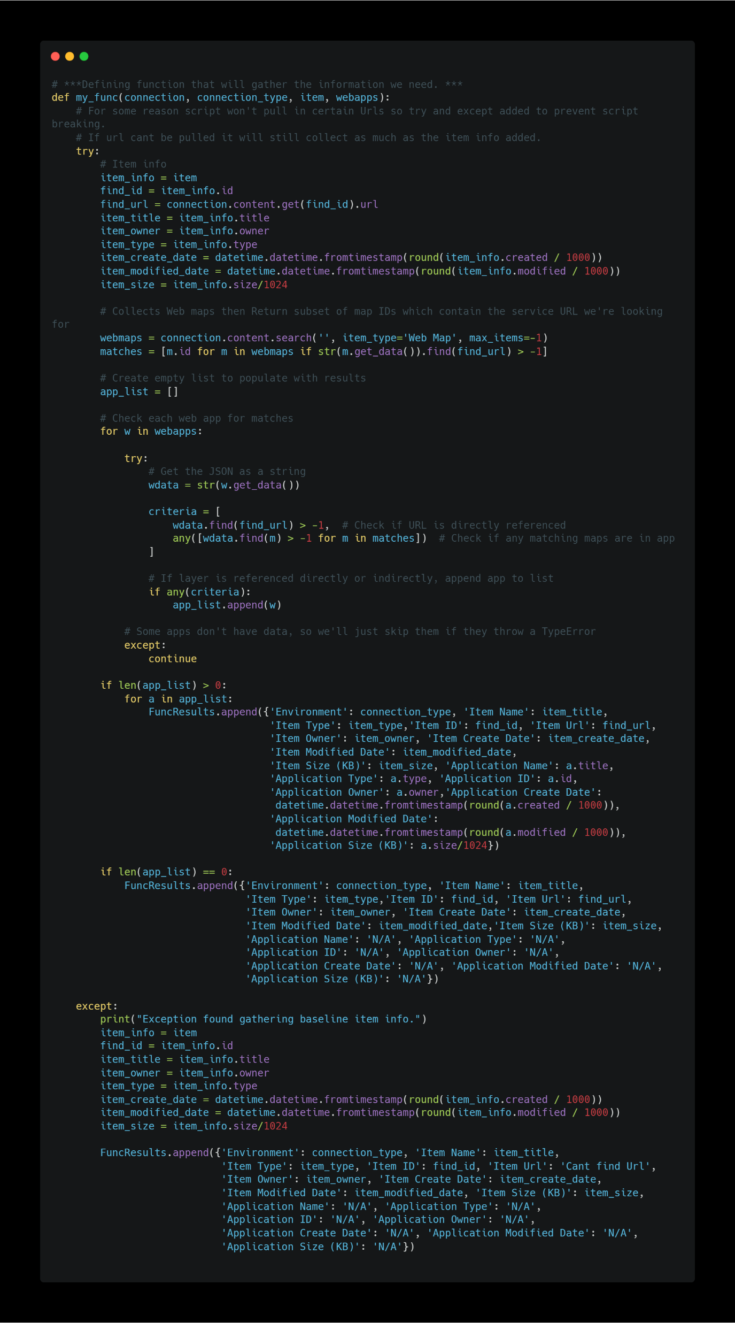
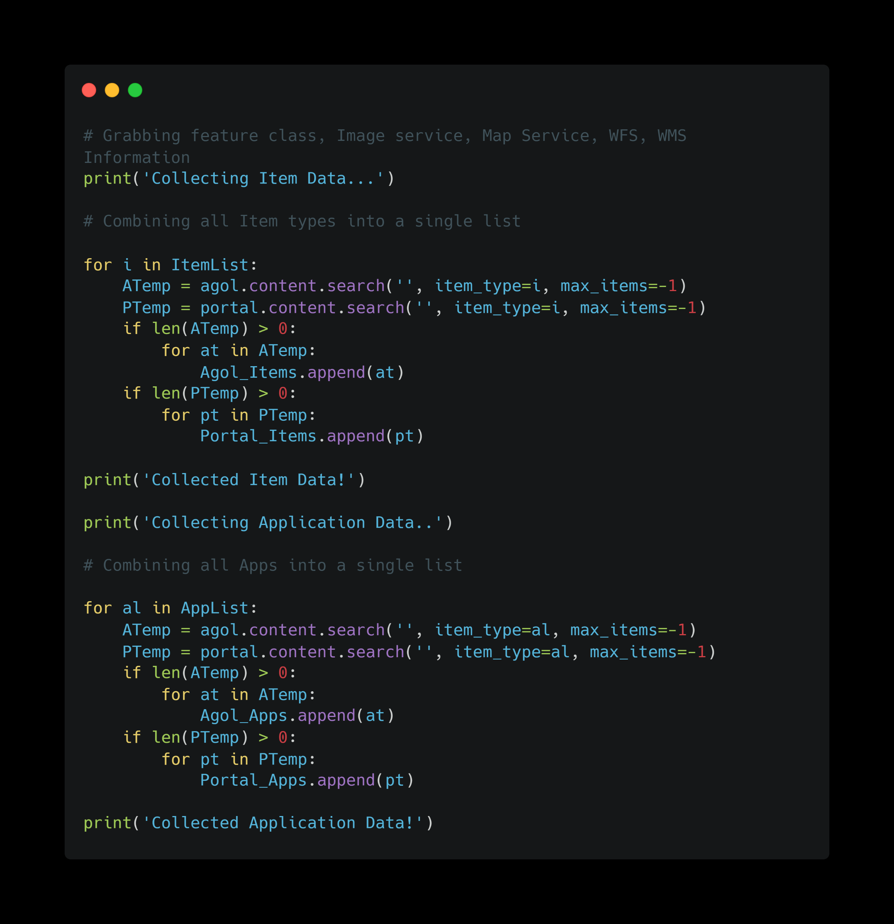
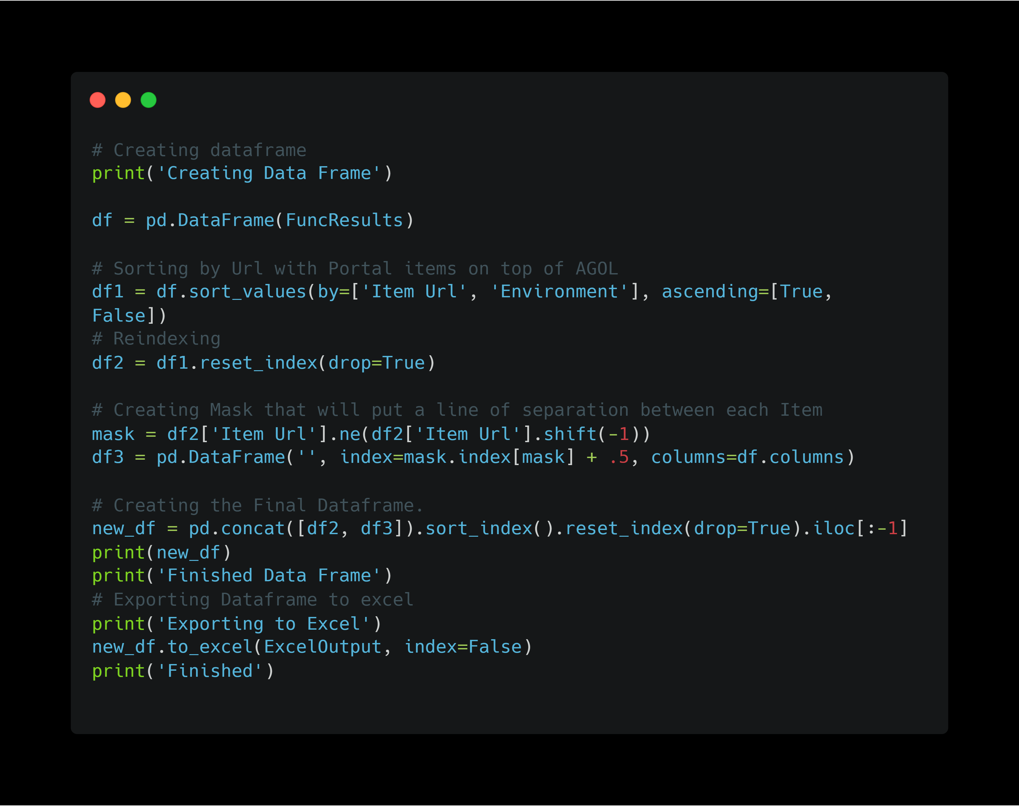
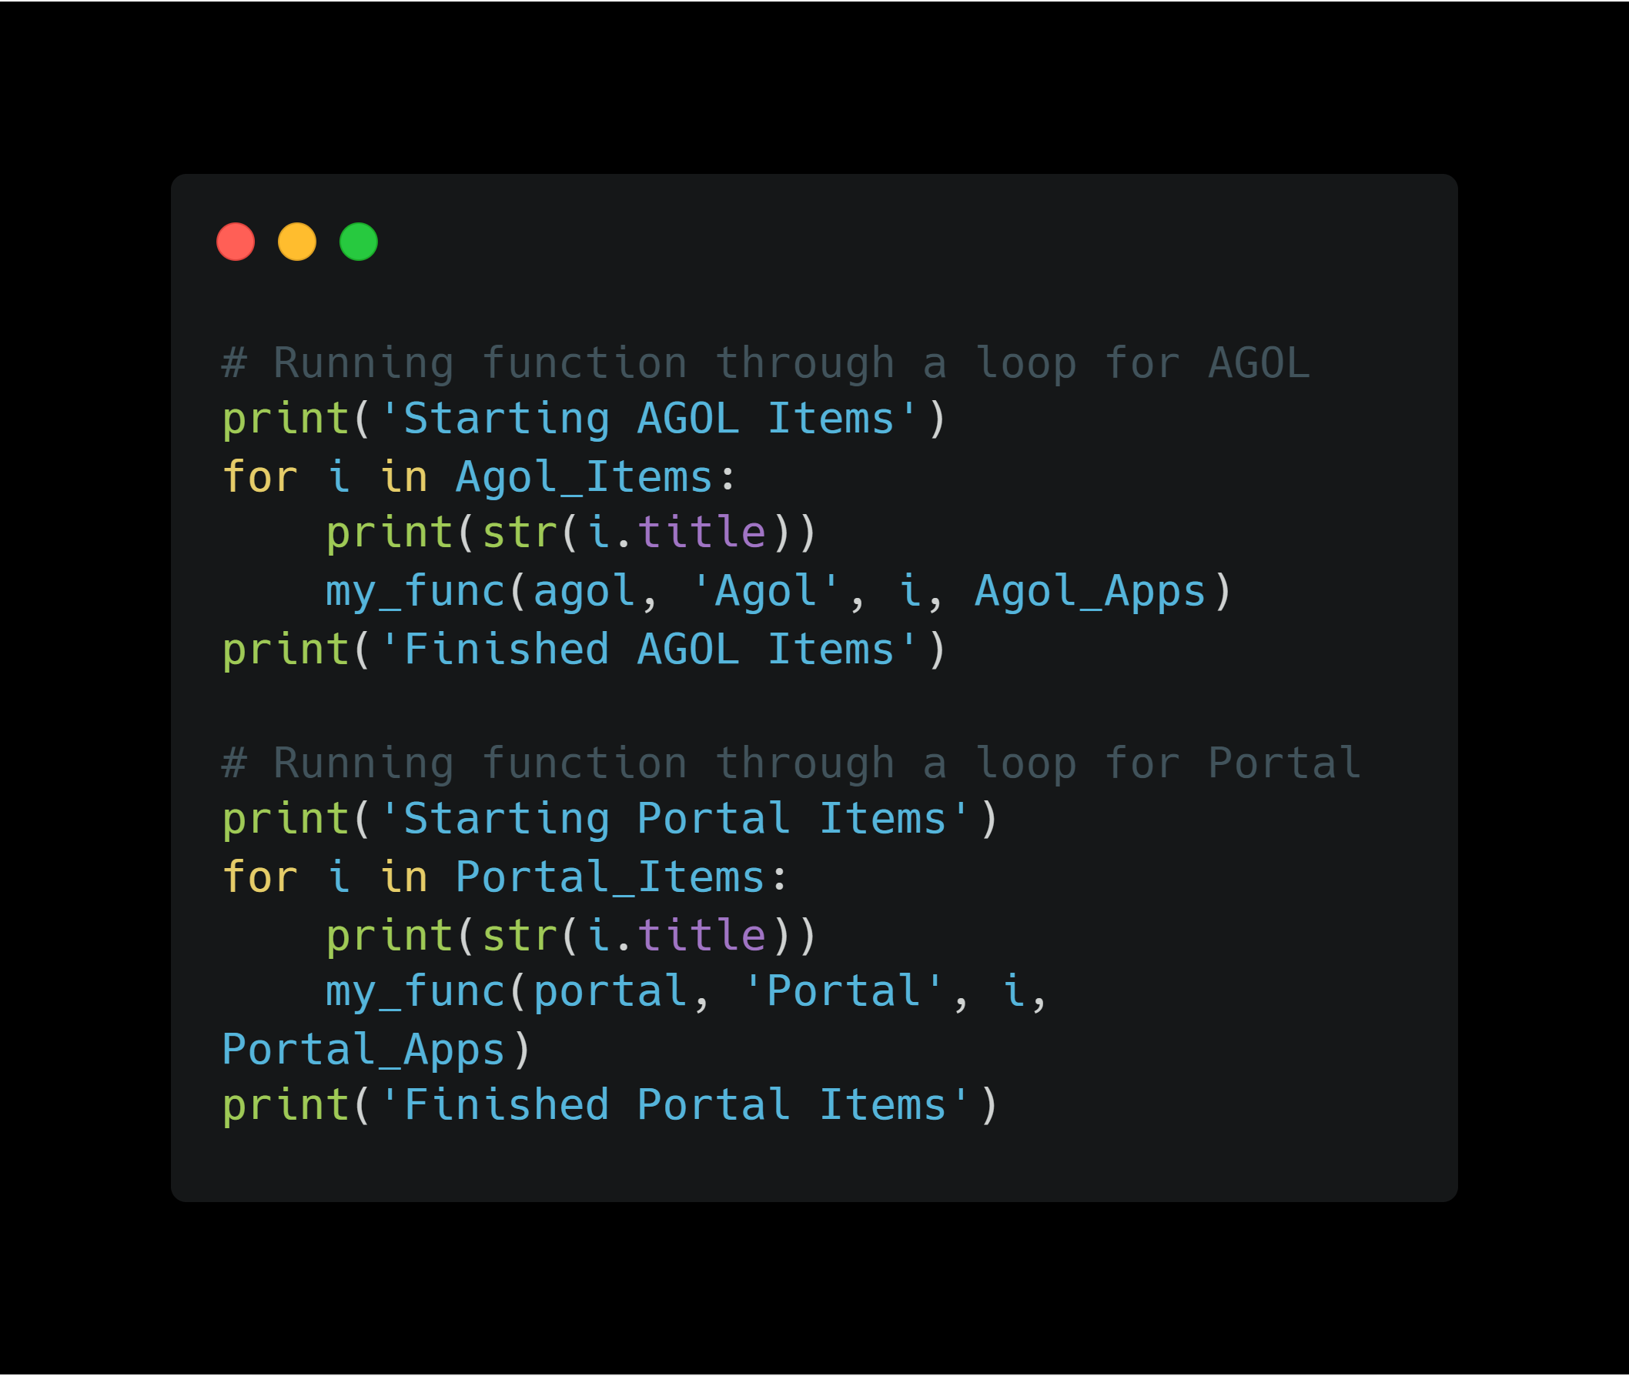
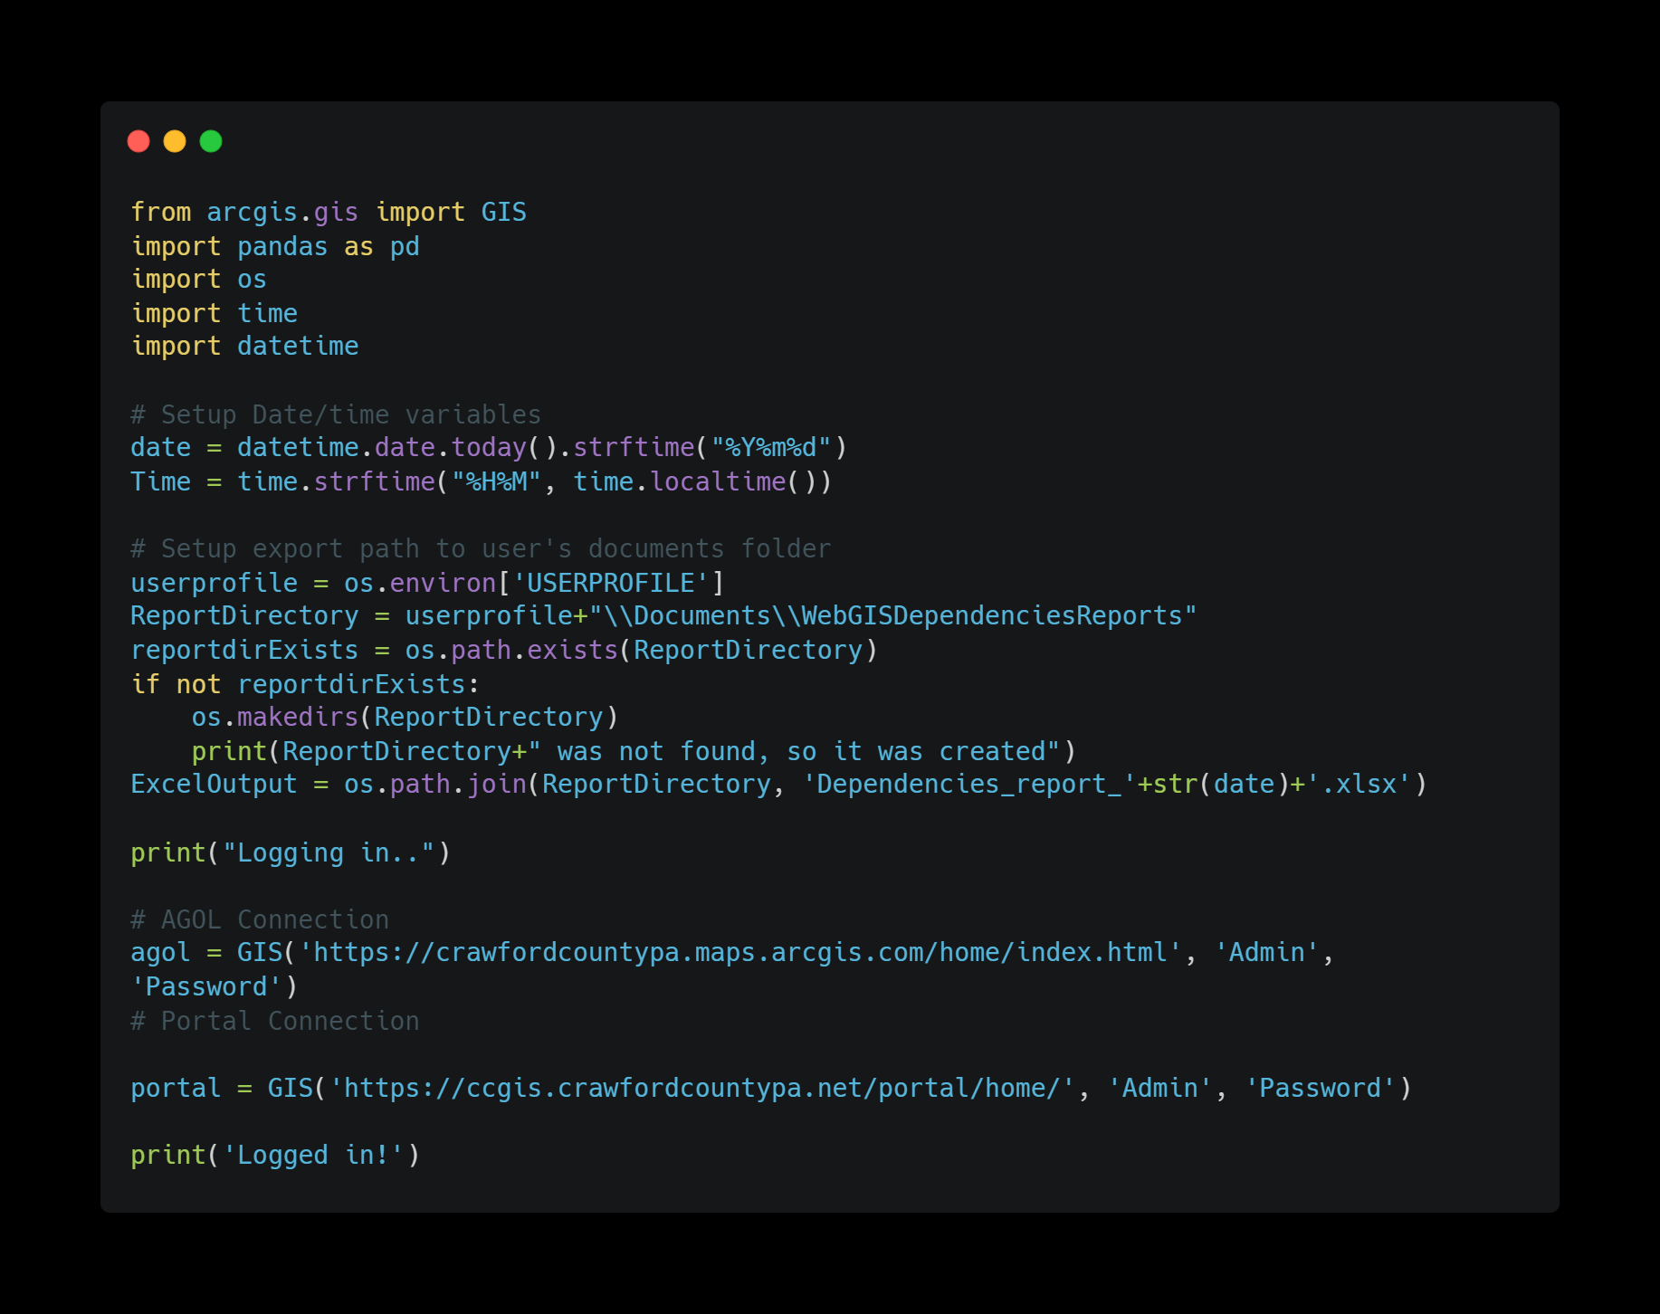
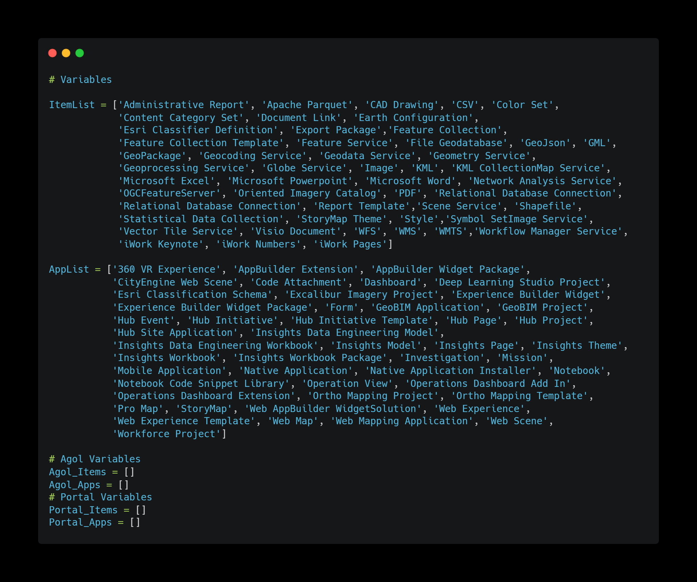
The Final Script
Notes:
For this example I’ll show the dual environment script
Break down script
First slide
Import libraries
Api, pandas, os, time, and datetime
Create output folder on the user’s documents folder
Connect to both AGOL & portal.
Ok I lied slightly in the dual script you’ll need 6 inputs 3 for each environment.
Second slide
Next up were going to store items and applications we can have in our environments into lists
Then Were going to store some empty variables to be used later
Third Slide
This is the brains of the whole operation. With this function I’ll be able to iterate through all the items in my environments one at a time.
4 parameters needed connection, connection type, item and web apps
Quickly explain Try and Except
First will get various information for said item including id, url, title etc.
Then we’ll find all the web maps then iterate through them to find matches.
Then we iterate through the webapps to find matching web apps if any.
First we need to get the JSON as a string
Then look to see if anything matches.
If anything does match append it to applist variable to be used later.
Then if the length of applist is greater then 0 we iterate through the list then append results to our empty variable.
If not append funcresults with N/A for application fields.
Lastly if we get an error trying to do any of the above script we export a slightly different version of the same append. This catches the few classes that doesn’t store an exact url.

Slide 14
The Output
Includes:
Item Name, Item Type, ID, URL, Owner, Item Create Date, Item Modified Date & Item Size.
Application Name, Application Type, Application ID, Application Owner, Application Create Date, Application Modified Date & Application Size.
Let’s see the results

Slide 15
Questions
Contact Info:
aparkin@co.crawford.pa.us
www.crawfordcountypa.net/gis
GitHub
Notes:
Slides will be available on the county website early next week if you need a refresher on anything.
Again like I said before please don’t hesitate to steal my code or tweak it to meet your needs. Also please don’t hesitate to reach out if you have any questions we don’t get to today.

